Slide 1
Inner-orbital ionization of iodine G. N. Gibson, D. Smith, J. Dragan University of Connecticut V. Tagliamonti Stony Brook University
DAMOP 2016
Providence, RI
May 24, 2016
Funding from the National Science Foundation

Slide 2
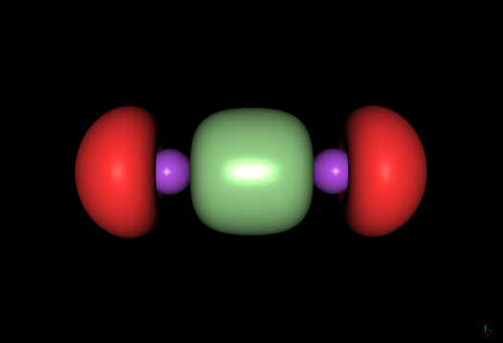
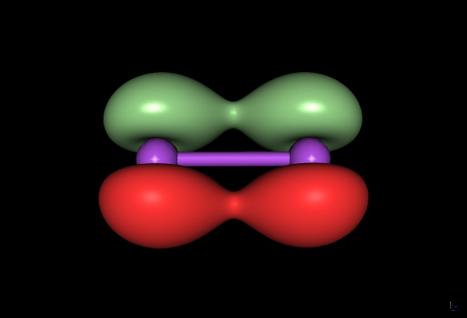
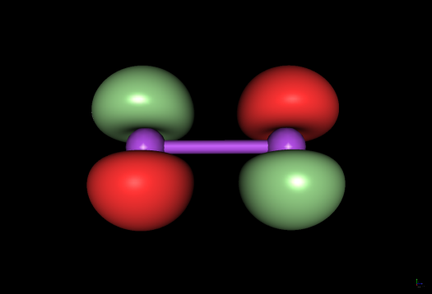
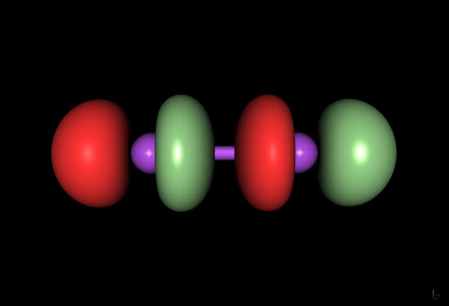
Molecules in Strong Laser Fields
To what extent do inner-orbitals play a role in the strong-field interaction?
Can we learn anything about the structure of molecular orbitals with strong laser fields?
Clearly, under certain circumstances inner-orbital ionization is important but, first, we need to understand which orbitals are involved.
σ_{g}
π_{u}
π_{g}
σ_{u}

Slide 3
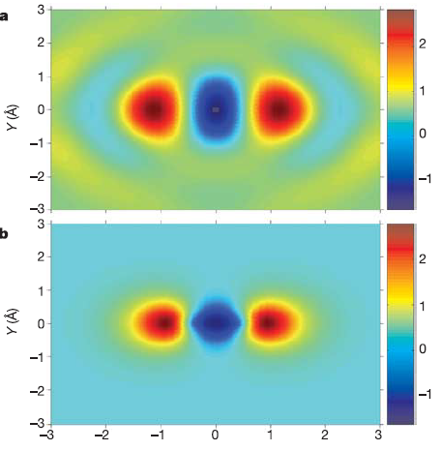
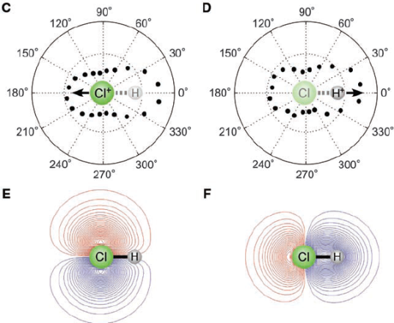
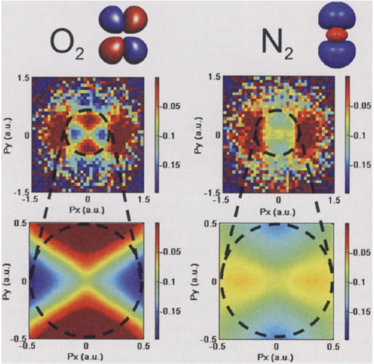
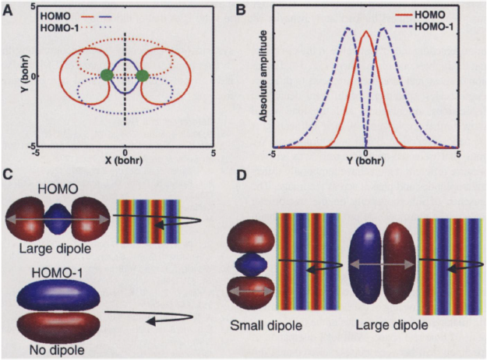
Methods for looking at orbitals
Ionization
High-harmonic
generation
Villeneuve, Corkum, et. al.,
Nature 432, 867 (2004).
Villeneuve, Corkum, et. al., Science 325, 1364 (2009).
Electron diffraction
Inner-orbital high-harmonic generation
Villeneuve, Corkum, et. al.,
Science 320, 1478 (2008).
Bucksbaum, Gühr, et. al.,
Science 422, 1232 (2008).

Slide 4
However, we first must understand single electron ionization
Reconstruction techniques often work for light molecules, like N₂ and O₂. But, assumptions might break down for heavy molecules, like I₂.

Slide 5
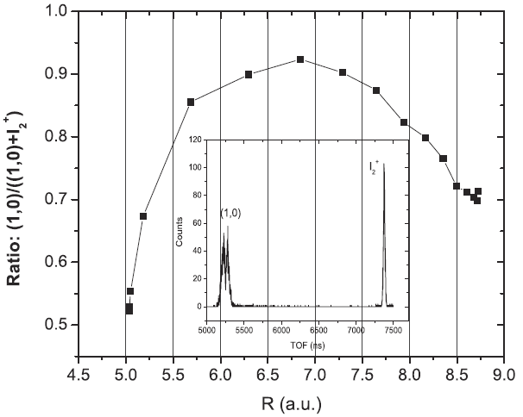
However, we first must understand single electron ionization
Reconstruction techniques often work for light molecules, like N₂ and O₂. But, assumptions might break down for heavy molecules, like I₂.
I₂ is interesting, as dissociation (I + I⁺) is more likely than the stable ion (I₂⁺).

Slide 6
However, we first must understand single electron ionization
Reconstruction techniques often work for light molecules, like N₂ and O₂. But, assumptions might break down for heavy molecules, like I₂.
I₂ is interesting, as dissociation (I + I⁺) is more likely than the stable ion (I₂⁺).
Because I₂ is heavy, we can decouple ionization and dissociation. Under these circumstances, the kinetic energy release (KER) should be easy to analyze.

Slide 7
However, we first must understand single electron ionization
Reconstruction techniques often work for light molecules, like N₂ and O₂. But, assumptions might break down for heavy molecules, like I₂.
I₂ is interesting, as dissociation (I + I⁺) is more likely than the stable ion (I₂⁺).
Because I₂ is heavy, we can decouple ionization and dissociation. Under these circumstances, the kinetic energy release (KER) should be easy to analyze.
As it turns out, the KER results cannot be explained by ionization of the HOMO, HOMO-1, or HOMO-2 orbitals. We must invoke the 5s² electrons.

Slide 8
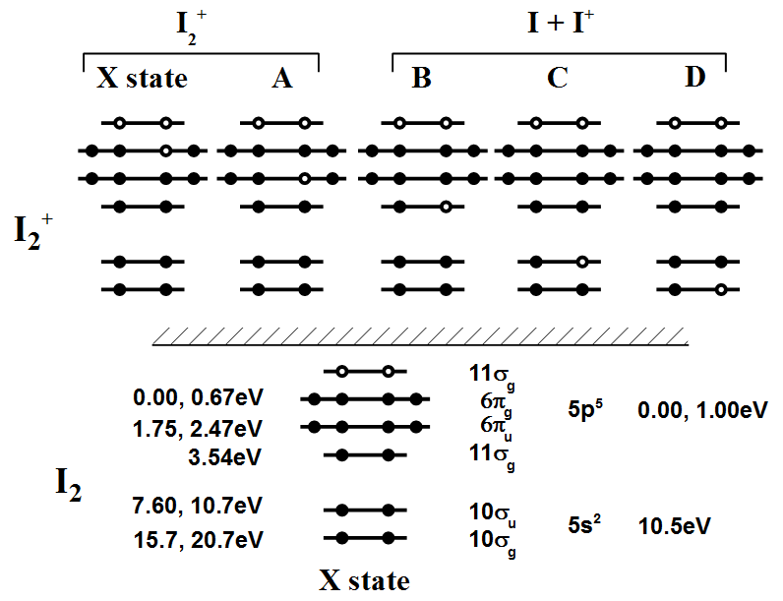
Orbital structure of I₂

Slide 9
Evidence for inner-orbital ionization in N₂ and I₂
Charge-asymmetric dissociation (N₂⁴⁺ →N⁺ + N³⁺): generally means excitation:
3+
2+
2+
1+

Slide 10
Evidence for inner-orbital ionization in N₂ and I₂
Fragments ionize more easily than they should: evidence of excited state fragments
3+
1+
2+
0+
*

Slide 11
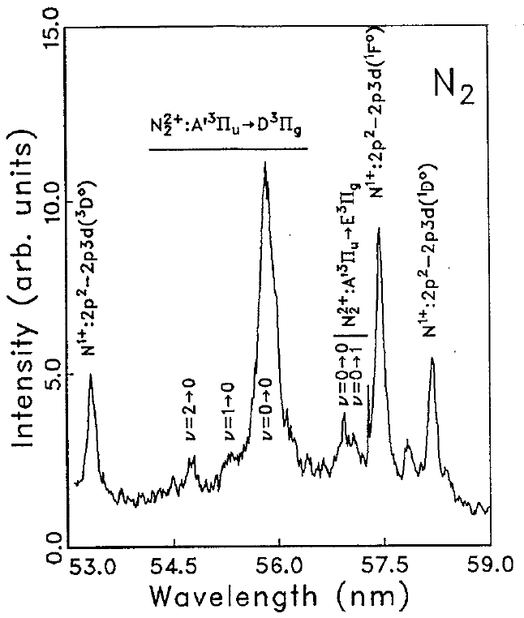
Evidence for inner-orbital ionization in N₂ and I₂
VUV Molecular fluorescence: again shows excitation, but line identification was uncertain.

Slide 12
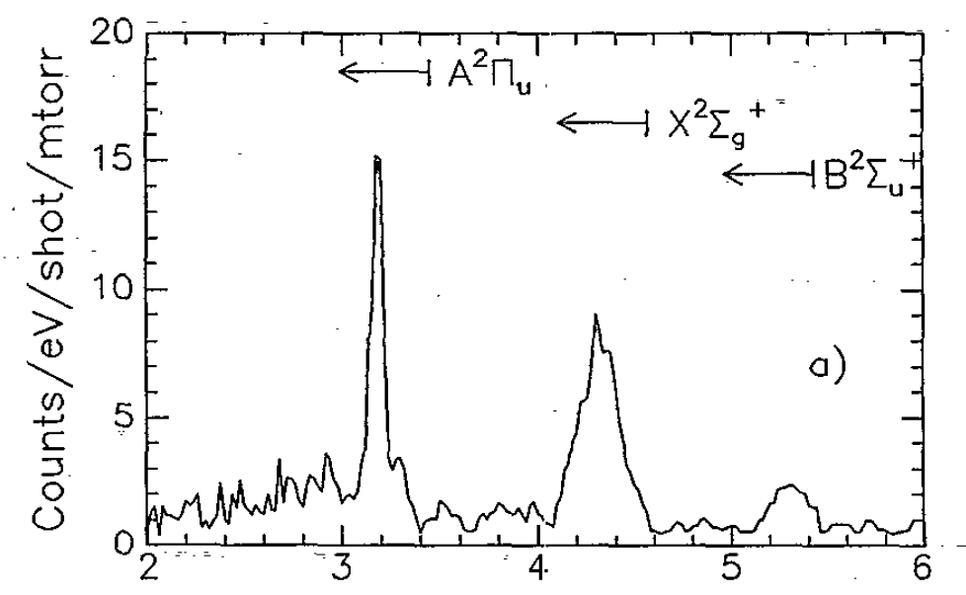
Evidence for inner-orbital ionization in N₂ and I₂
Electron spectroscopy: clear signature of inner orbital ionization

Slide 13
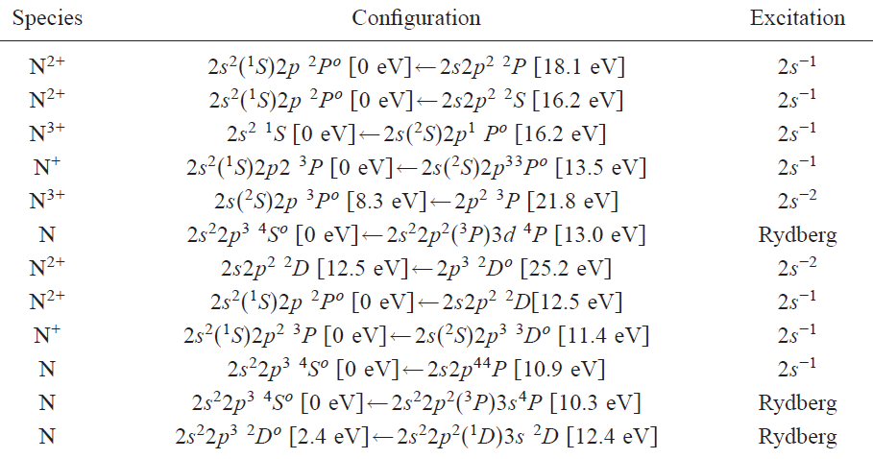
Evidence for inner-orbital ionization in N₂ and I₂
VUV atomic Nitrogen fluorescence: gives most specific insight into mechanism. All direct excitation involve 2s holes.

Slide 14
Orbital structure of I₂

Slide 15
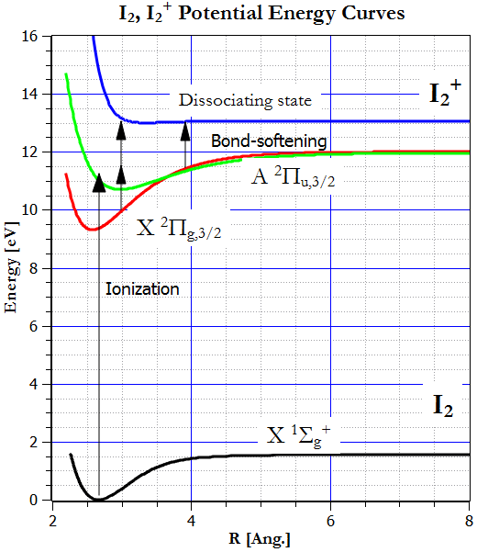
What do we expect to see for dissociation?
Only very low energy fragments

Slide 16
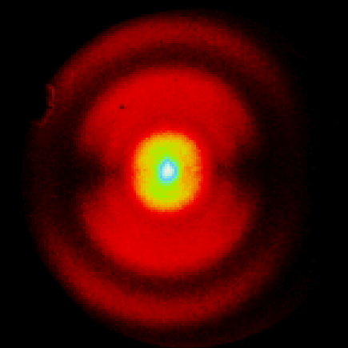
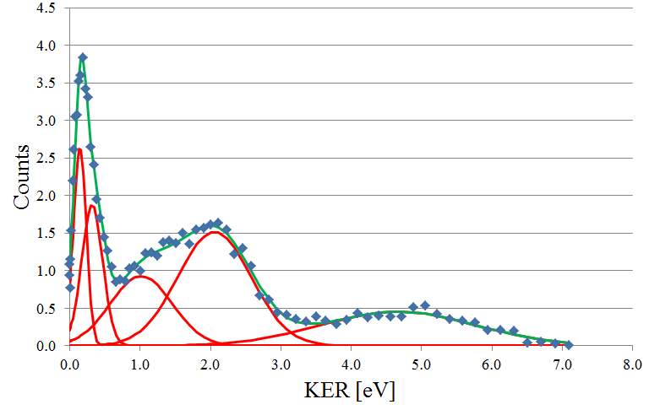
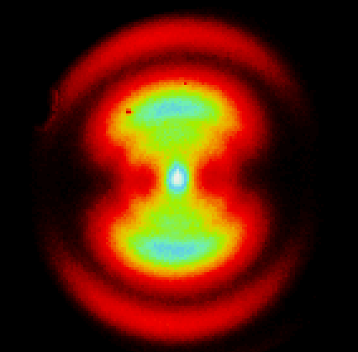
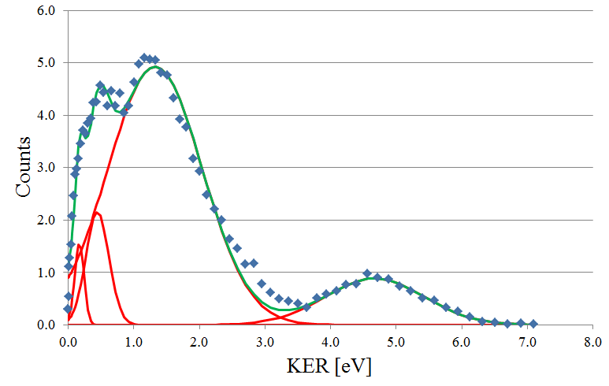
What do we see?
400 nm
B state
I₂²⁺
(1,1)
714 nm
B state
(1,1)

Slide 17
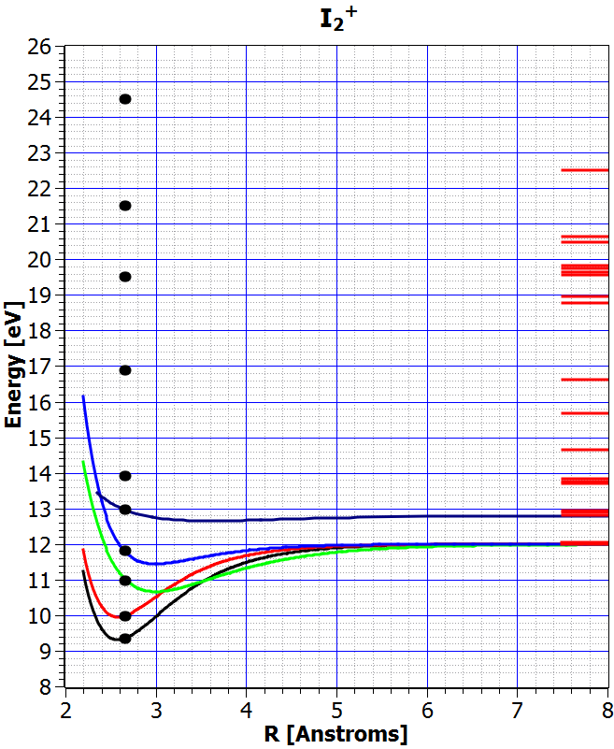
What are all of the possibilities for dissociation?
Molecular data
We need more pathways
Dissociation limits from NIST Atomic database

Slide 18
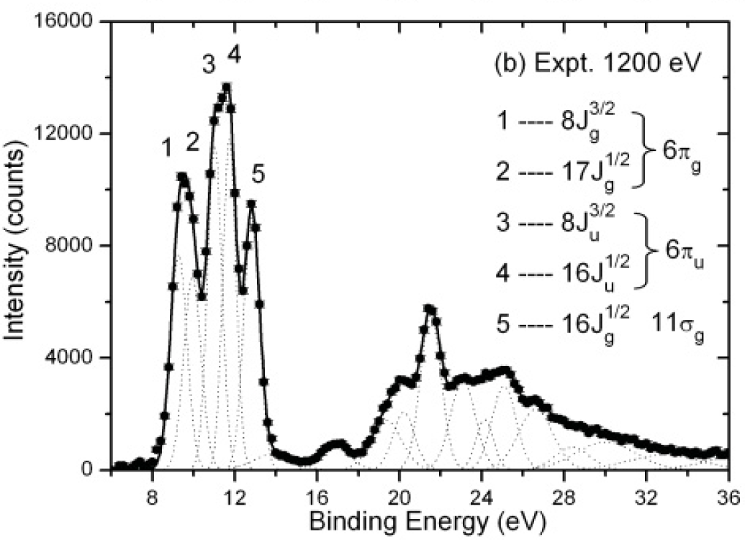
Where are the higher energy levels?
X_{3/2}
X_{1/2}
A_{3/2}
A_{1/2}
B

Slide 19
What are all of the possibilities for dissociation?
Molecular data
Dissociation limits from NIST Atomic database

Slide 20
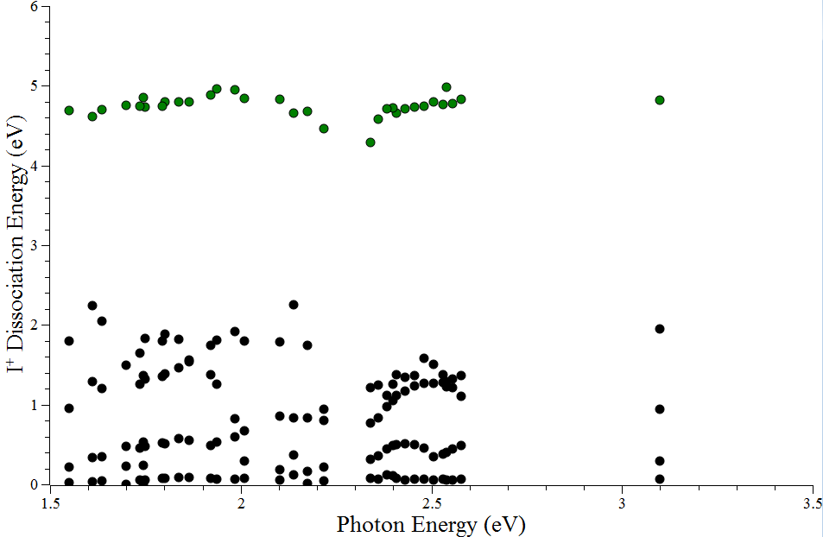
Dissociation energy vs. photon energy
(1,1)
Possible 1-photon assist, but does not correspond to the right well depth for the X or A states.
Slope = 1; Intercept = 1.5
B state

Slide 21
What are all of the possibilities for dissociation?
Molecular data
Dissociation limits from NIST Atomic database

Slide 22
Conclusions
The kinetic energy release spectrum of I + I⁺ following strong field ionization of I₂ is very hard to identify, in detail.
Ionization to the X, A, and B states, corresponding to the HOMO, HOMO-1, and HOMO-2, do not explain most of the data.
From this we conclude that we couple strongly to the inner orbitals built on the 5s² electrons, just as was seen previously in N₂.
Deep inner orbital coupling may occur through electron localization present at R_{equilibrium}.
Thank you!

Slide 23
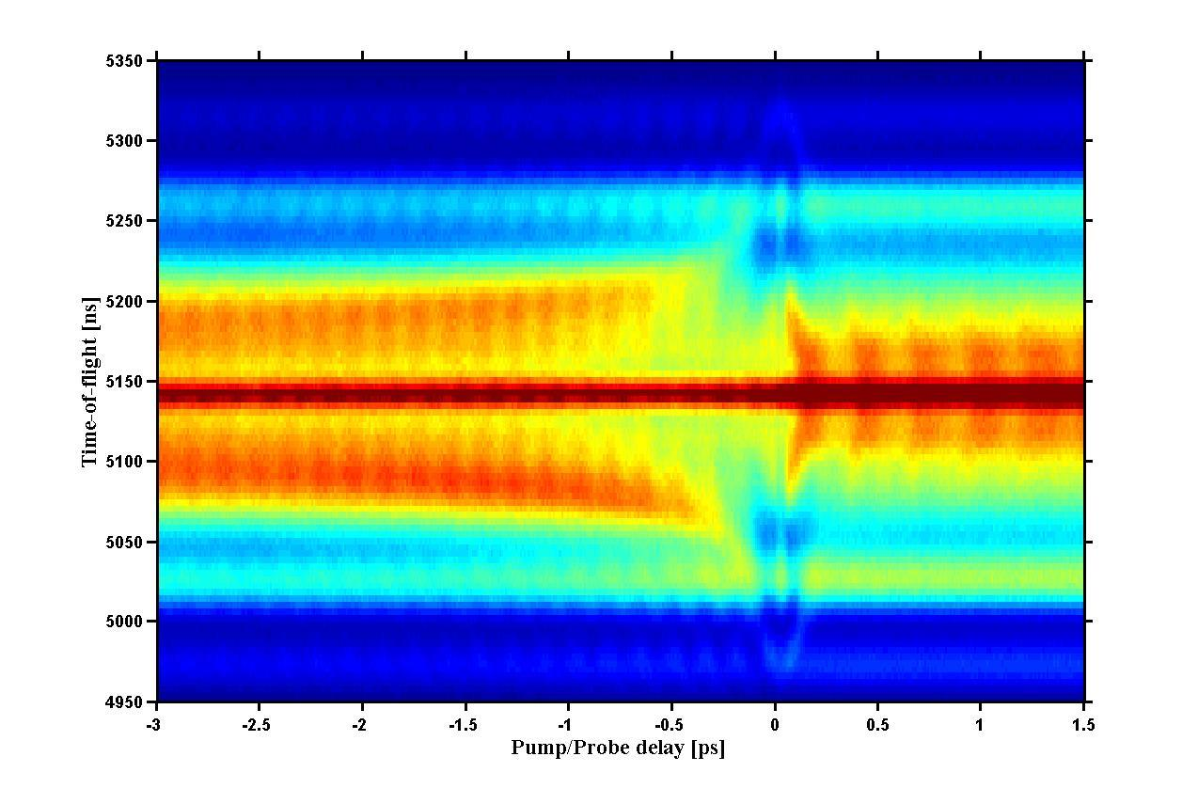
Rich vibrational structure in I₂ pump-probe experiments

