Slide 1
Enhanced harmonic generation in double-well potentials
George N. Gibson
University of Connecticut
Graduate students:
Katya Sergen
Dale Smith
James Dragan
Funding: NSF
DAMOP 2015 Columbus, OH June 8-12, 2015

Slide 2
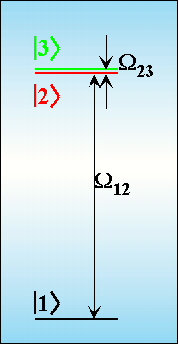
Outline
High multiphoton susceptibility of the Γ-system:
Strong multiphoton excitation
Strong harmonic generation
Double-well potentials contain the Γ-system
Doubly ionized potentials work well (A₂²⁺)
What about neutral potentials (A₂)? These are much more practical
Performed both n-level and TDSE calculations
Double-well potentials have large MP susceptibility, even in the presence of other levels.

Slide 3
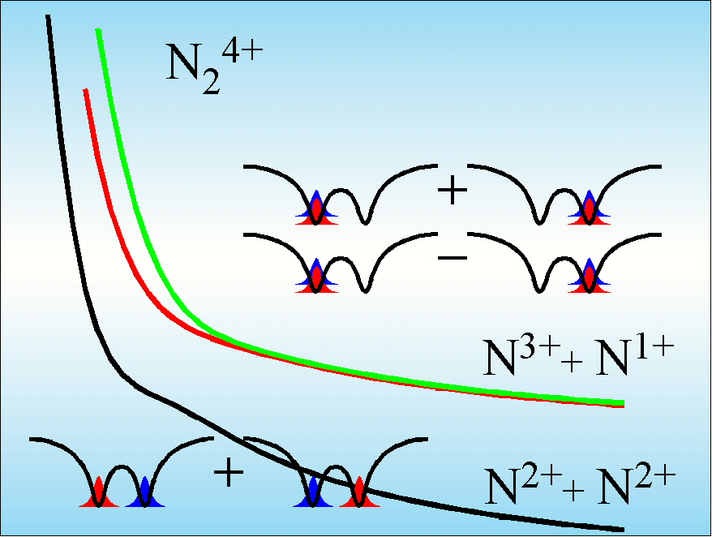
What is special about even-charged diatomic molecules?
Strongly coupled pair of excited states and a weakly coupled ground state.

Slide 4
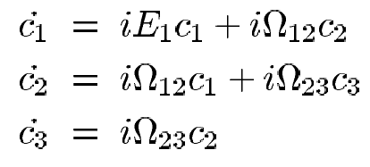
3-Level Model System
This system can be solved exactly for the n-photon Rabi frequency!

Slide 5
Γ-system Literature

Slide 6
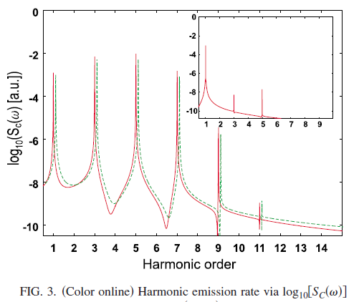
Γ-system: Harmonic Generation

Slide 7
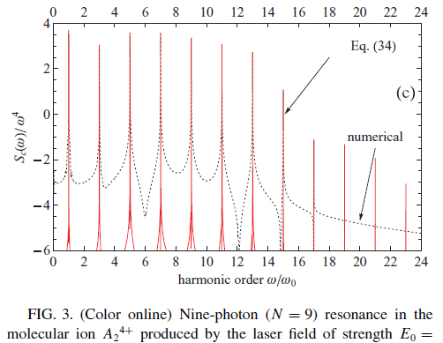
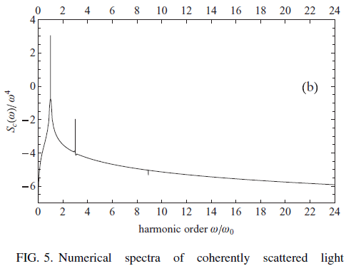
Γ-system: Harmonic Generation

Slide 8
1-D 2-electron double-well model:
Harmonic generation:

Slide 9
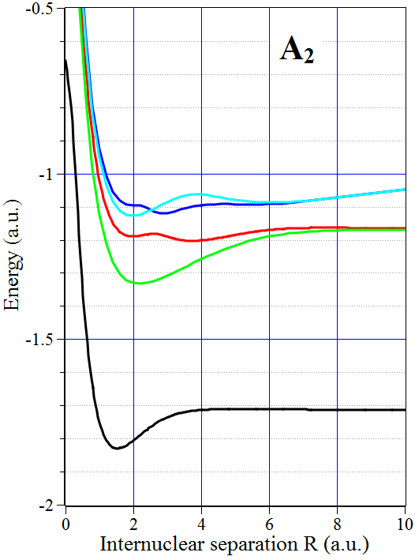
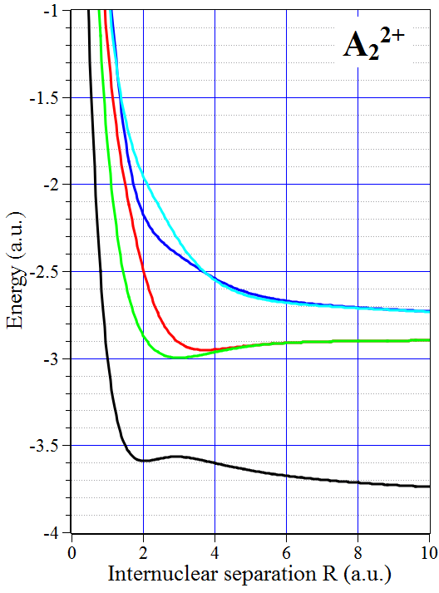
Double well energy levels:
Ionic
Covalent
Covalent
Ionic
A³⁺ + A¹⁺
A²⁺ + A²⁺

Slide 10
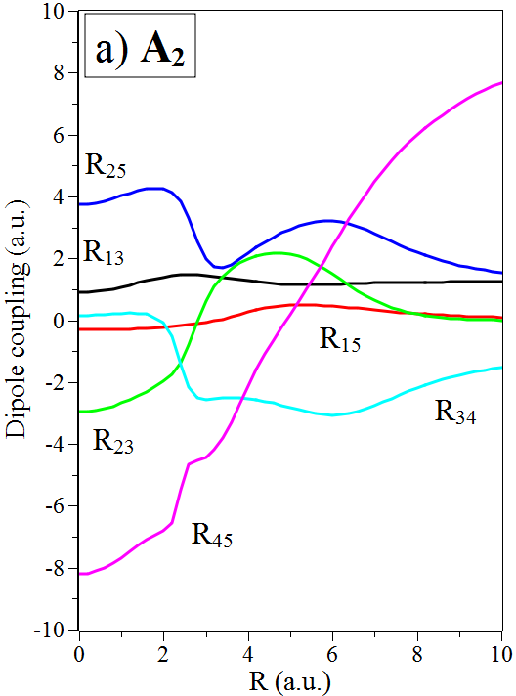
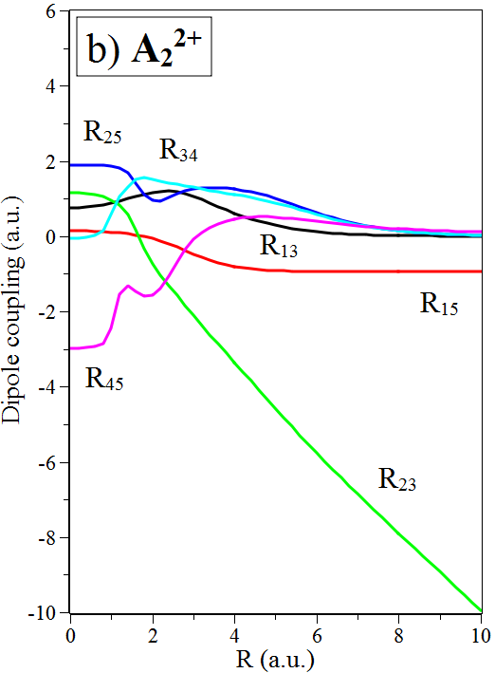
Double well energy levels:
Ionic
Covalent
Ionic

Slide 11
Harmonic generation from A₂²⁺
Small R
Intermediate R

Slide 12
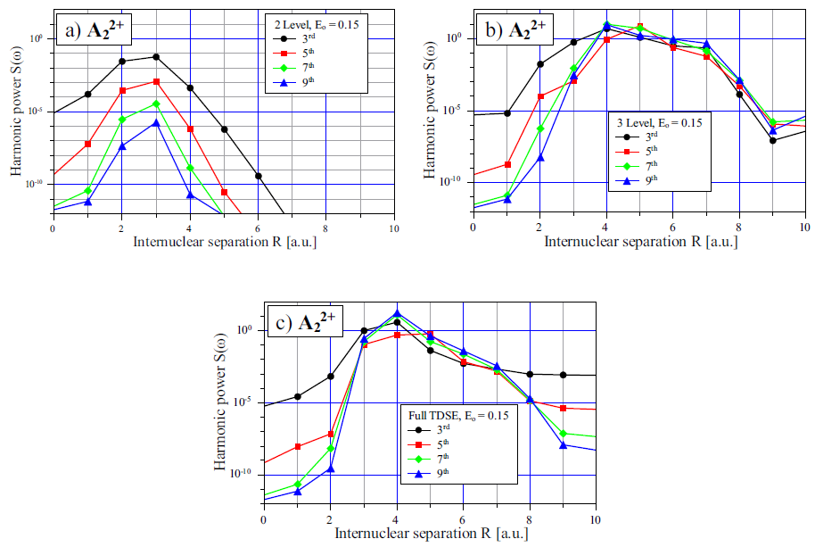
Harmonic generation from A₂²⁺

Slide 13
Harmonic generation from A₂
Small R
Intermediate R

Slide 14
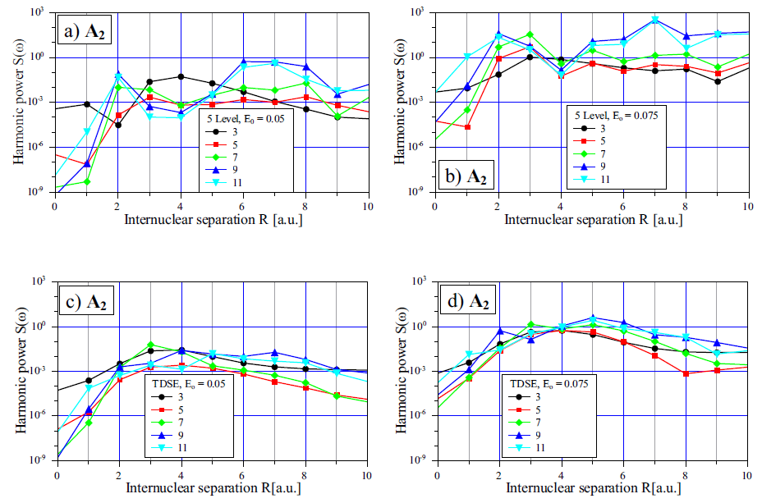
Harmonic generation from A₂

Slide 15
Double well energy levels:
Ionic
Covalent
Ionic

Slide 16
Double well energy levels:
Ionic
Covalent
Covalent
Ionic
A³⁺ + A¹⁺
A²⁺ + A²⁺

Slide 17
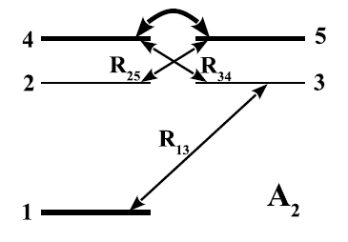
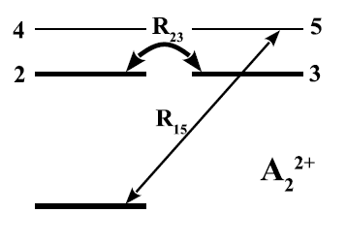
Dipole couplings at large R:

Slide 18
Conclusions
A pair of nearly degenerate strongly coupled states, like those found in diatomic molecules greatly enhances multiphoton couplings.
In particular, low order harmonic generation is strongly enhanced and becomes non-perturbative.
Presence of covalent states in the neutral molecule are not detrimental.
Requires diatomic molecules at moderate internuclear separations.
Question: what is the optimal energy level structure for a particular nonlinear process?

Slide 19
Thank you for listening!

Slide 20
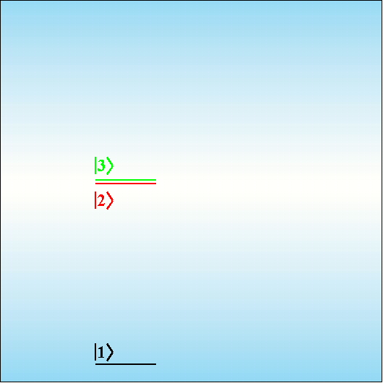
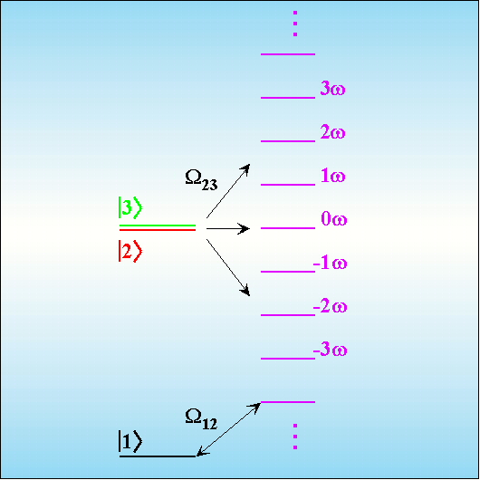
Perfect Floquet Ladder of States:
Level 1 couples to the -(n-1) Floquet state through Ω₁₂. Since this is only a 1-photon interaction the AC Stark shift is small.

