Slide 1
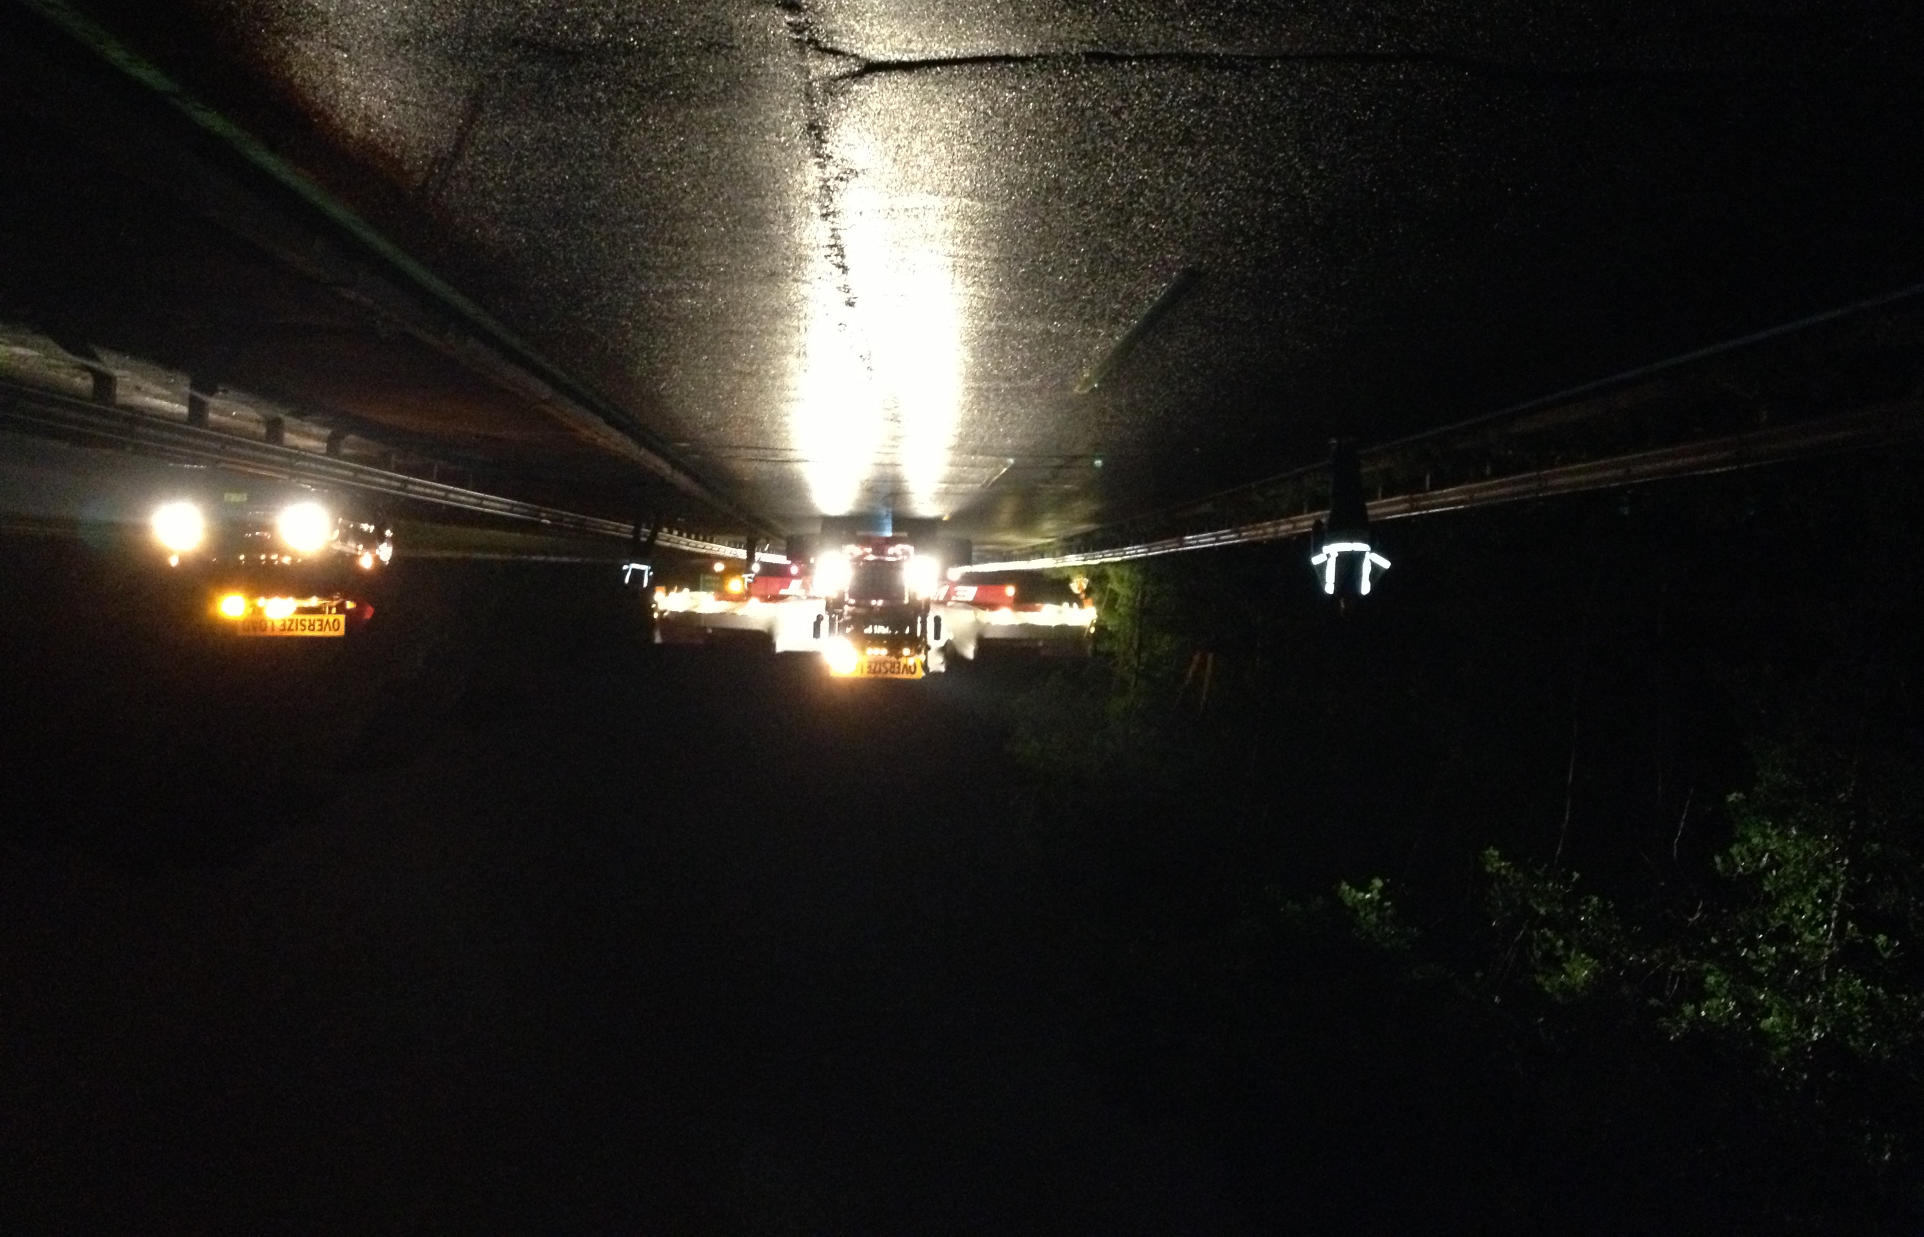
The Fermilab Muon (g - 2) Experiment:
Status and Outlook
Lee Roberts – Boston University

Slide 2







Muon g-2 Collaboration
US Universities
  Boston
  Cornell
  Illinois
  James Madison
  Kentucky
  Massachusetts
  Michigan
  Michigan State
  Mississippi
  Northern Illinois
  Regis
  Texas
  Virginia
  Washington
National Labs
  Argonne
  Brookhaven
  Fermilab
Italy
  INFN
    LNF Frascati,
    Naples
    Pisa
    Roma 2
    Trieste
    Lecce
  Udine
  Naples
  Trieste
  Rjeka
  Molise
  SNS Pisa
China:
  Shanghai
Germany:
  Dresden (thy)
England
  Cockroft Institute
  Lancaster
  Liverpool
  University College London
Korea
  KAIST
Russia:
  Dubna
  Novosibirsk

Slide 3
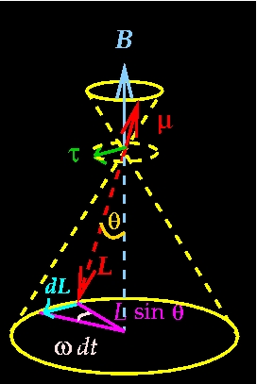
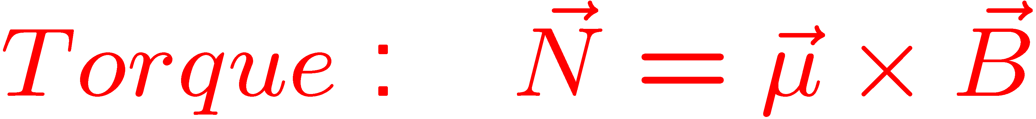
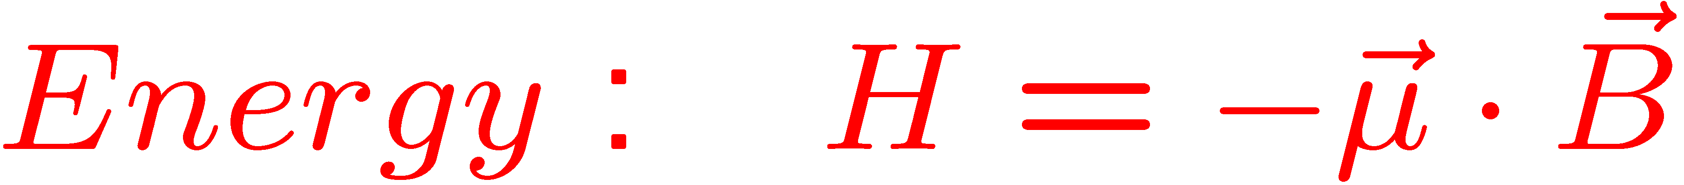
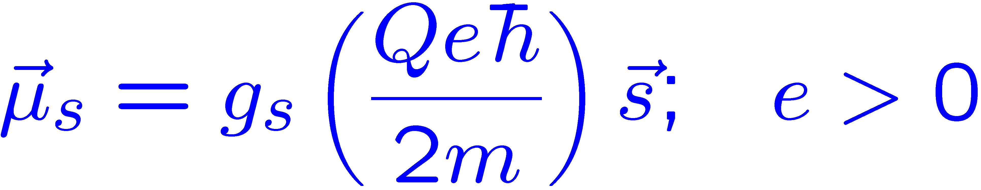
Magnetic Dipole Moments
Dipole in a B field:
μ_{s} for a particle with spin:
Larmor precession
Notes:
3

Slide 4
Outline
Introduction
  what and why
The spin equations and the technique
Measurement of the magnetic field ω_{p}
Measurement of the muon spin frequency ω_{a}
Status of the experiment
Summary

Slide 5
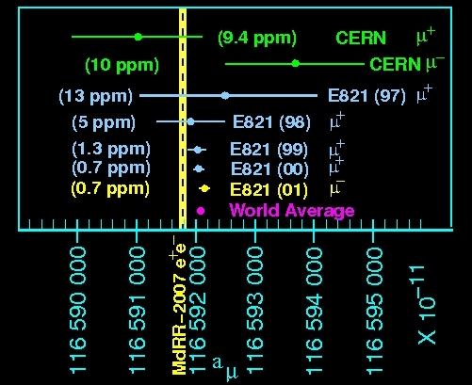
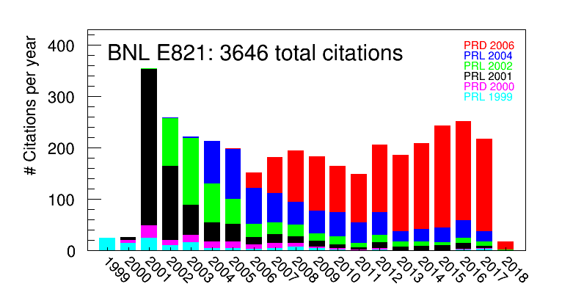
Comparison with Experiment
⁻ theory
as of 2/2018

Slide 6
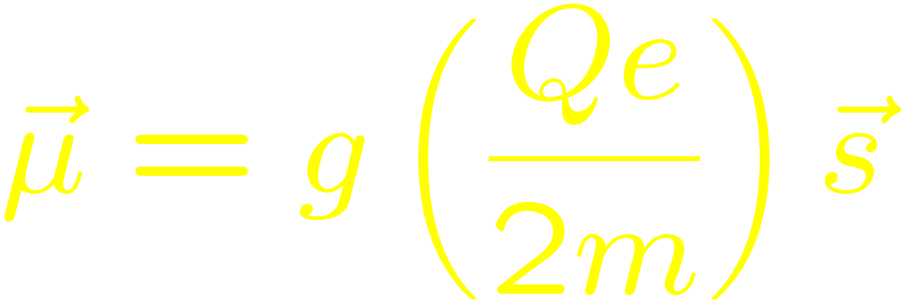
Measuring Lepton Magnetic Dipole Moments

Slide 7
I.I. Rabi
Never measure anything but frequency

Slide 8
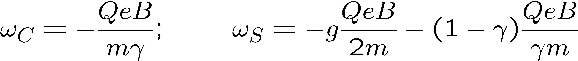
Spin Motion in a Magnetic Field
Particle: q = Qe moving in a magnetic field: momentum turns with cyclotron frequency ω_{C},
spin turns with ω_{S}
Spin turns relative to the momentum with ω_{a}
Note that Thomas precession cancels out in the difference frequency!

Slide 9
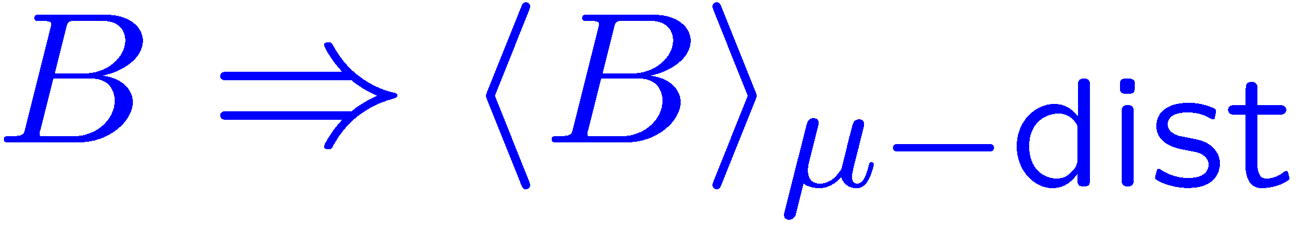
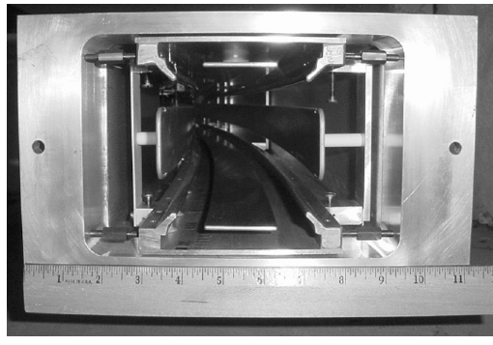
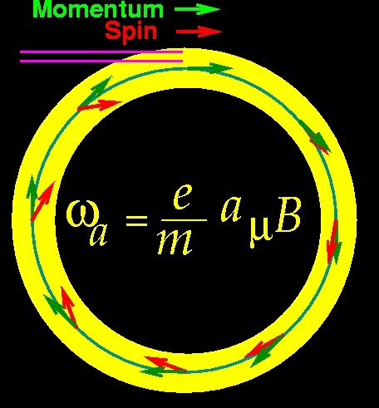
In a storage ring, we need vertical focusing
With an electric quadrupole field for vertical focusing and the magic γ
0
Measure two quantities
where B is expressed in terms of the Larmor frequency of a free proton, averaged over the muon distribution.

Slide 10
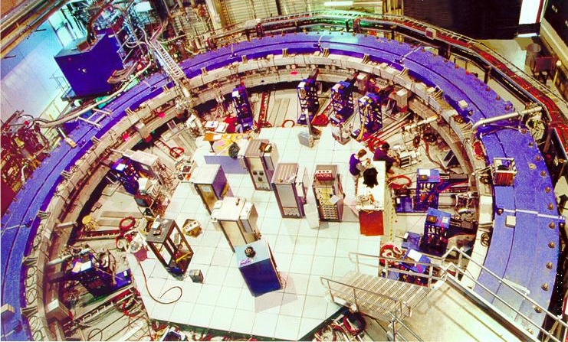
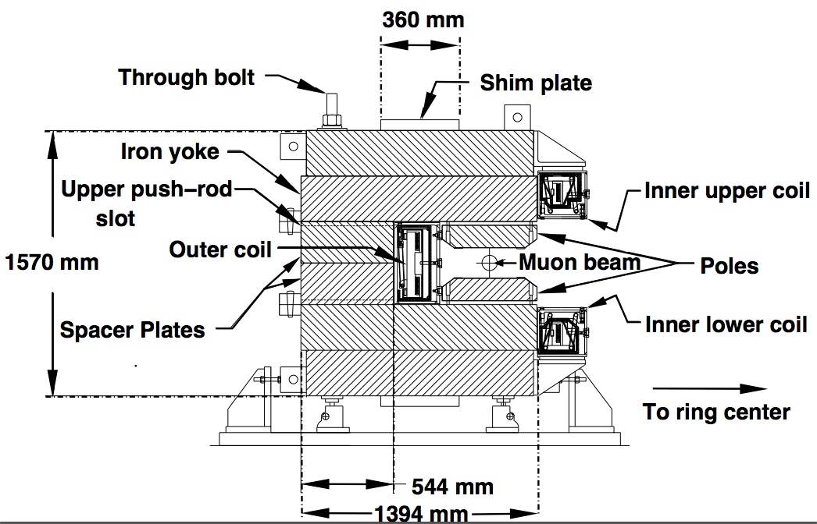
The Magnet (at BNL)
Muon lifetime γτ_{μ} = 64.4 μs
(g-2) period τ_{a} = 4.37 μs
Cyclotron period τ_{C} = 149 ns

Slide 11
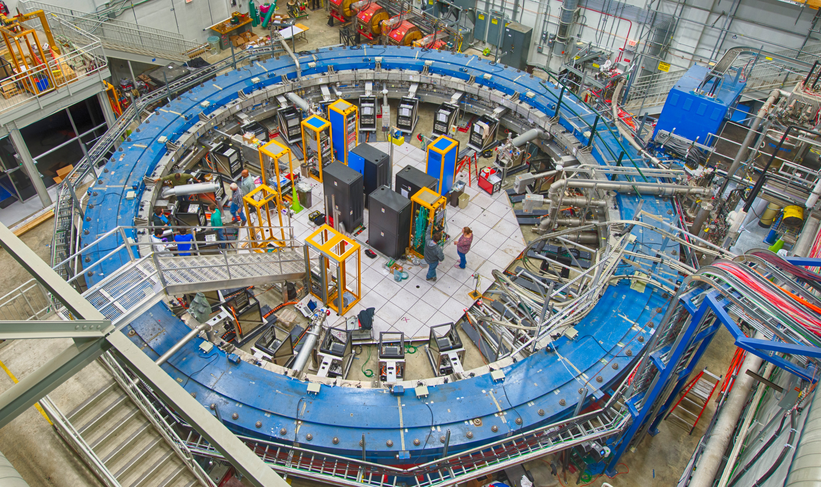
The Magnet (at Fermlab)
APRIL 2017
24 Calorimeter stations located all around the ring
Measure arrival time & energies of the decay e⁺

Slide 12
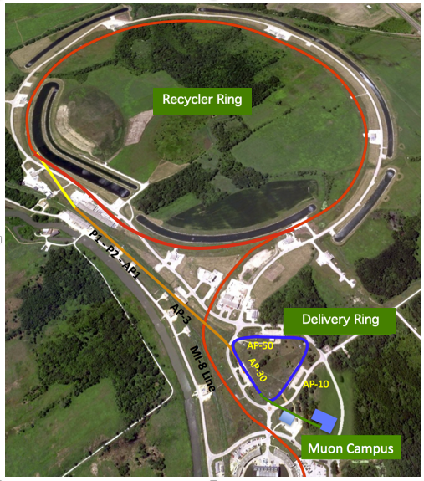
Beam: BNL
Fermilab
24 GeV/c proton beam
The pion decay channel is 80 m and the ring diameter is 14.1 m. Most μ are thrown away to minimize pion content of the beam. π/μ ≃ 1:1, big source of background
8 GeV/c proton beam from Booster
The pion decay channel is ≃ 2.4 km, No π left
Analyzed Events:
9 × 10⁹
E989
goal: 2 × 10¹¹

Slide 13
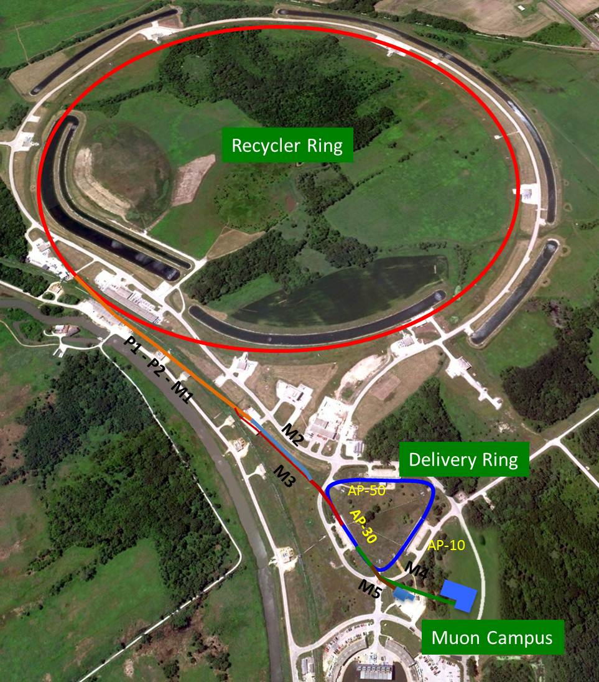
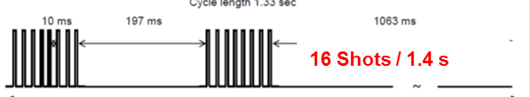
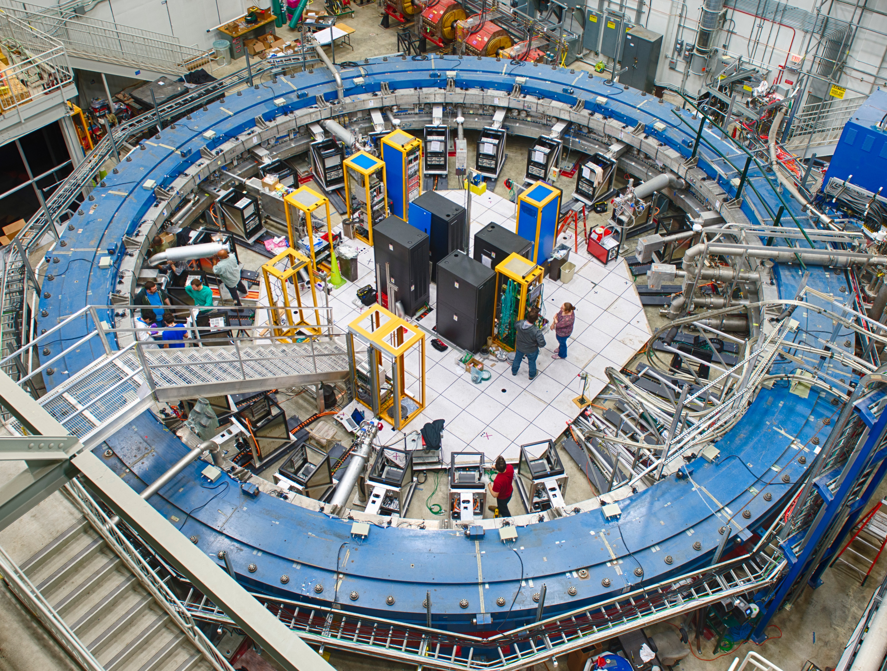
Muon g-2 Beam
8 GeV p batch into Recycler
Split into 4 bunches
Extract each bunch to strike target
Long FODO channel to collect π ◊ μν
p/π/μ beam enters DR; protons kicked out; π decay away
∼10,000 μ stored in ring per pulse
6/7/17

Slide 14
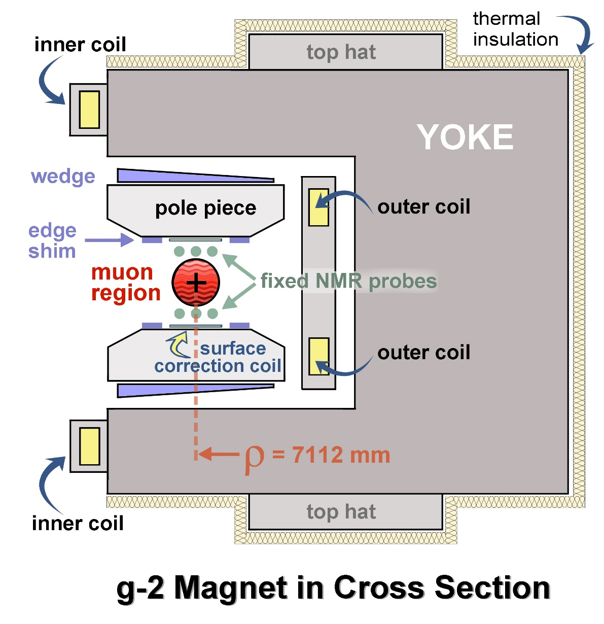
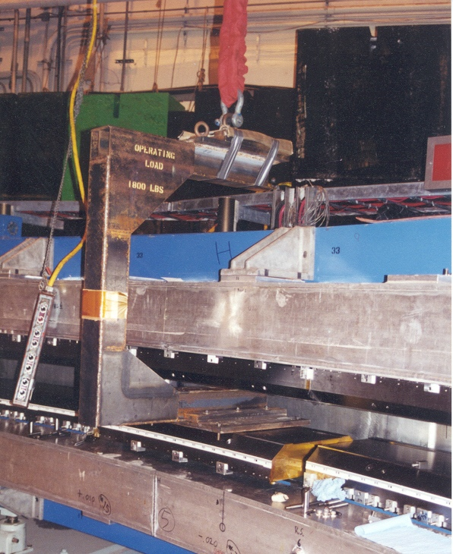
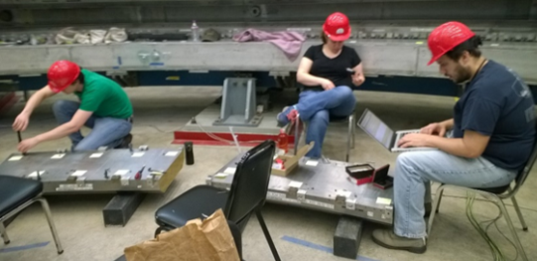
Built-in Shimming Tools provide many knobs
B Field 1.45T
12 Yokes: C shaped flux returns
24 Iron Top Hats: change effective μ
864 Wedges: angle - quadrupole (QP)) and dipole
72 Poles: shape field
Edge Shims: QP, sextapole (SP)
8000 Surface iron foils: change effective mu locally
Surface coils: will add average field moments (360 deg)
Notes:
controlling the size of air gaps..these are all the handles to control the air gap..to make field more uniform.
Red is the storage region, we move around different wedges (shimmining)
The goal is to manipulate things in the storage region

Slide 15
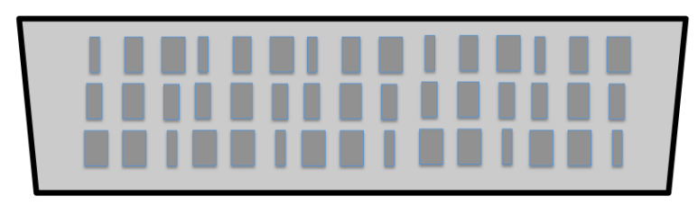
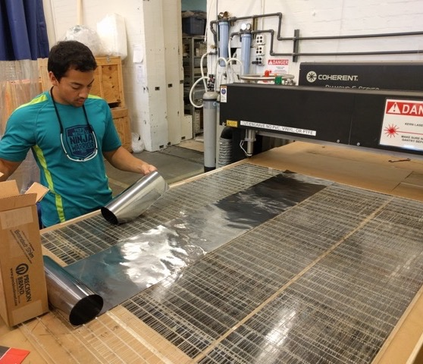
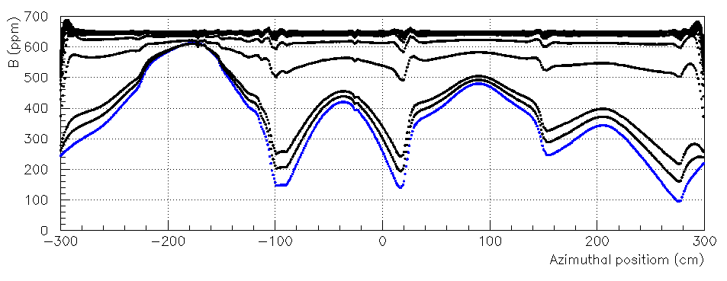
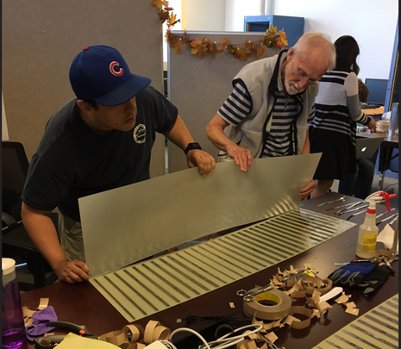
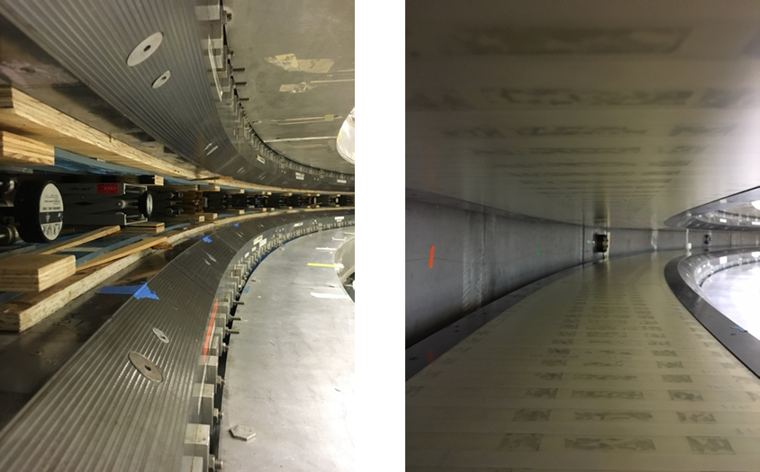
The final shimming tool: Iron Laminations
Cover each pole with a patchwork of foils in 41 azimuthal and 3 radial sections
CENPA
Determine optimal foil mass values by iterative procedure that minimizes field inhomogeneity around a target value
– Dave Kawall U Mass
Notes:
Fill in gaps with tiny iron laminations cut them in different sizes to fill in the missing piece of the magnetic field

Slide 16
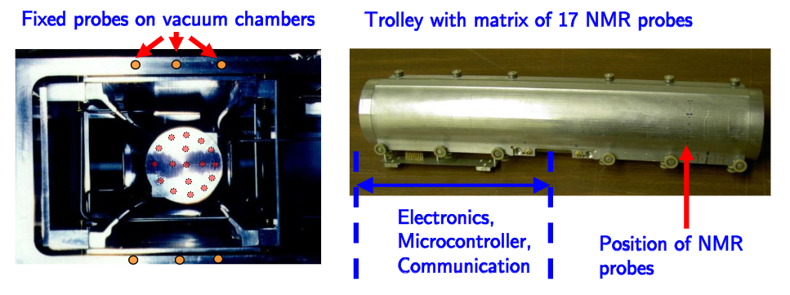
ω_{p} The Magnetic field:
Pulsed NMR. A π/2 pulse is applied to a petroleum jelly sample, and the free-induction-decay is digitized and analyzed to determine the FID frequency
We monitor the field during data collection with 378 NMR probes outside of the vacuum chamber.
We map the field inside of the ring with dedicated “trolley runs”
Through a series of steps using a spherical water probe, we calibrate to the Larmor frequency of a free proton.
petroleum jelly

Slide 17
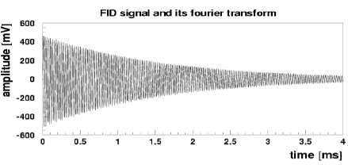
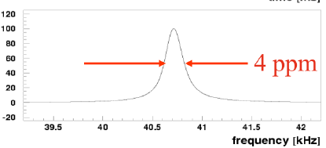
Pulsed NMR, Free Induction Decay

Slide 18
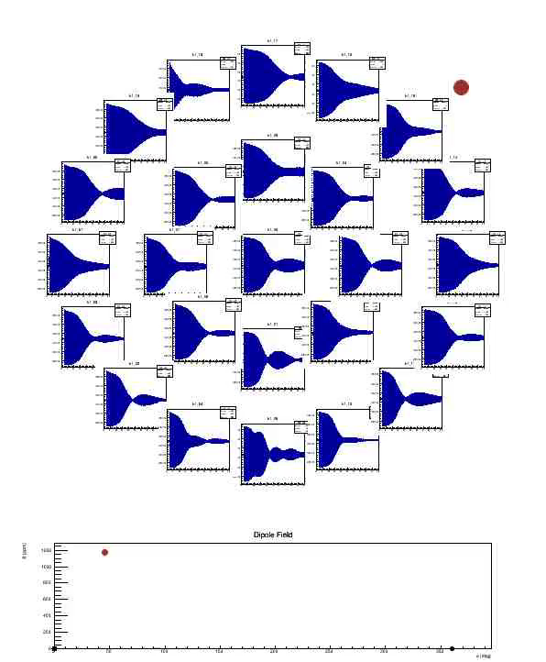
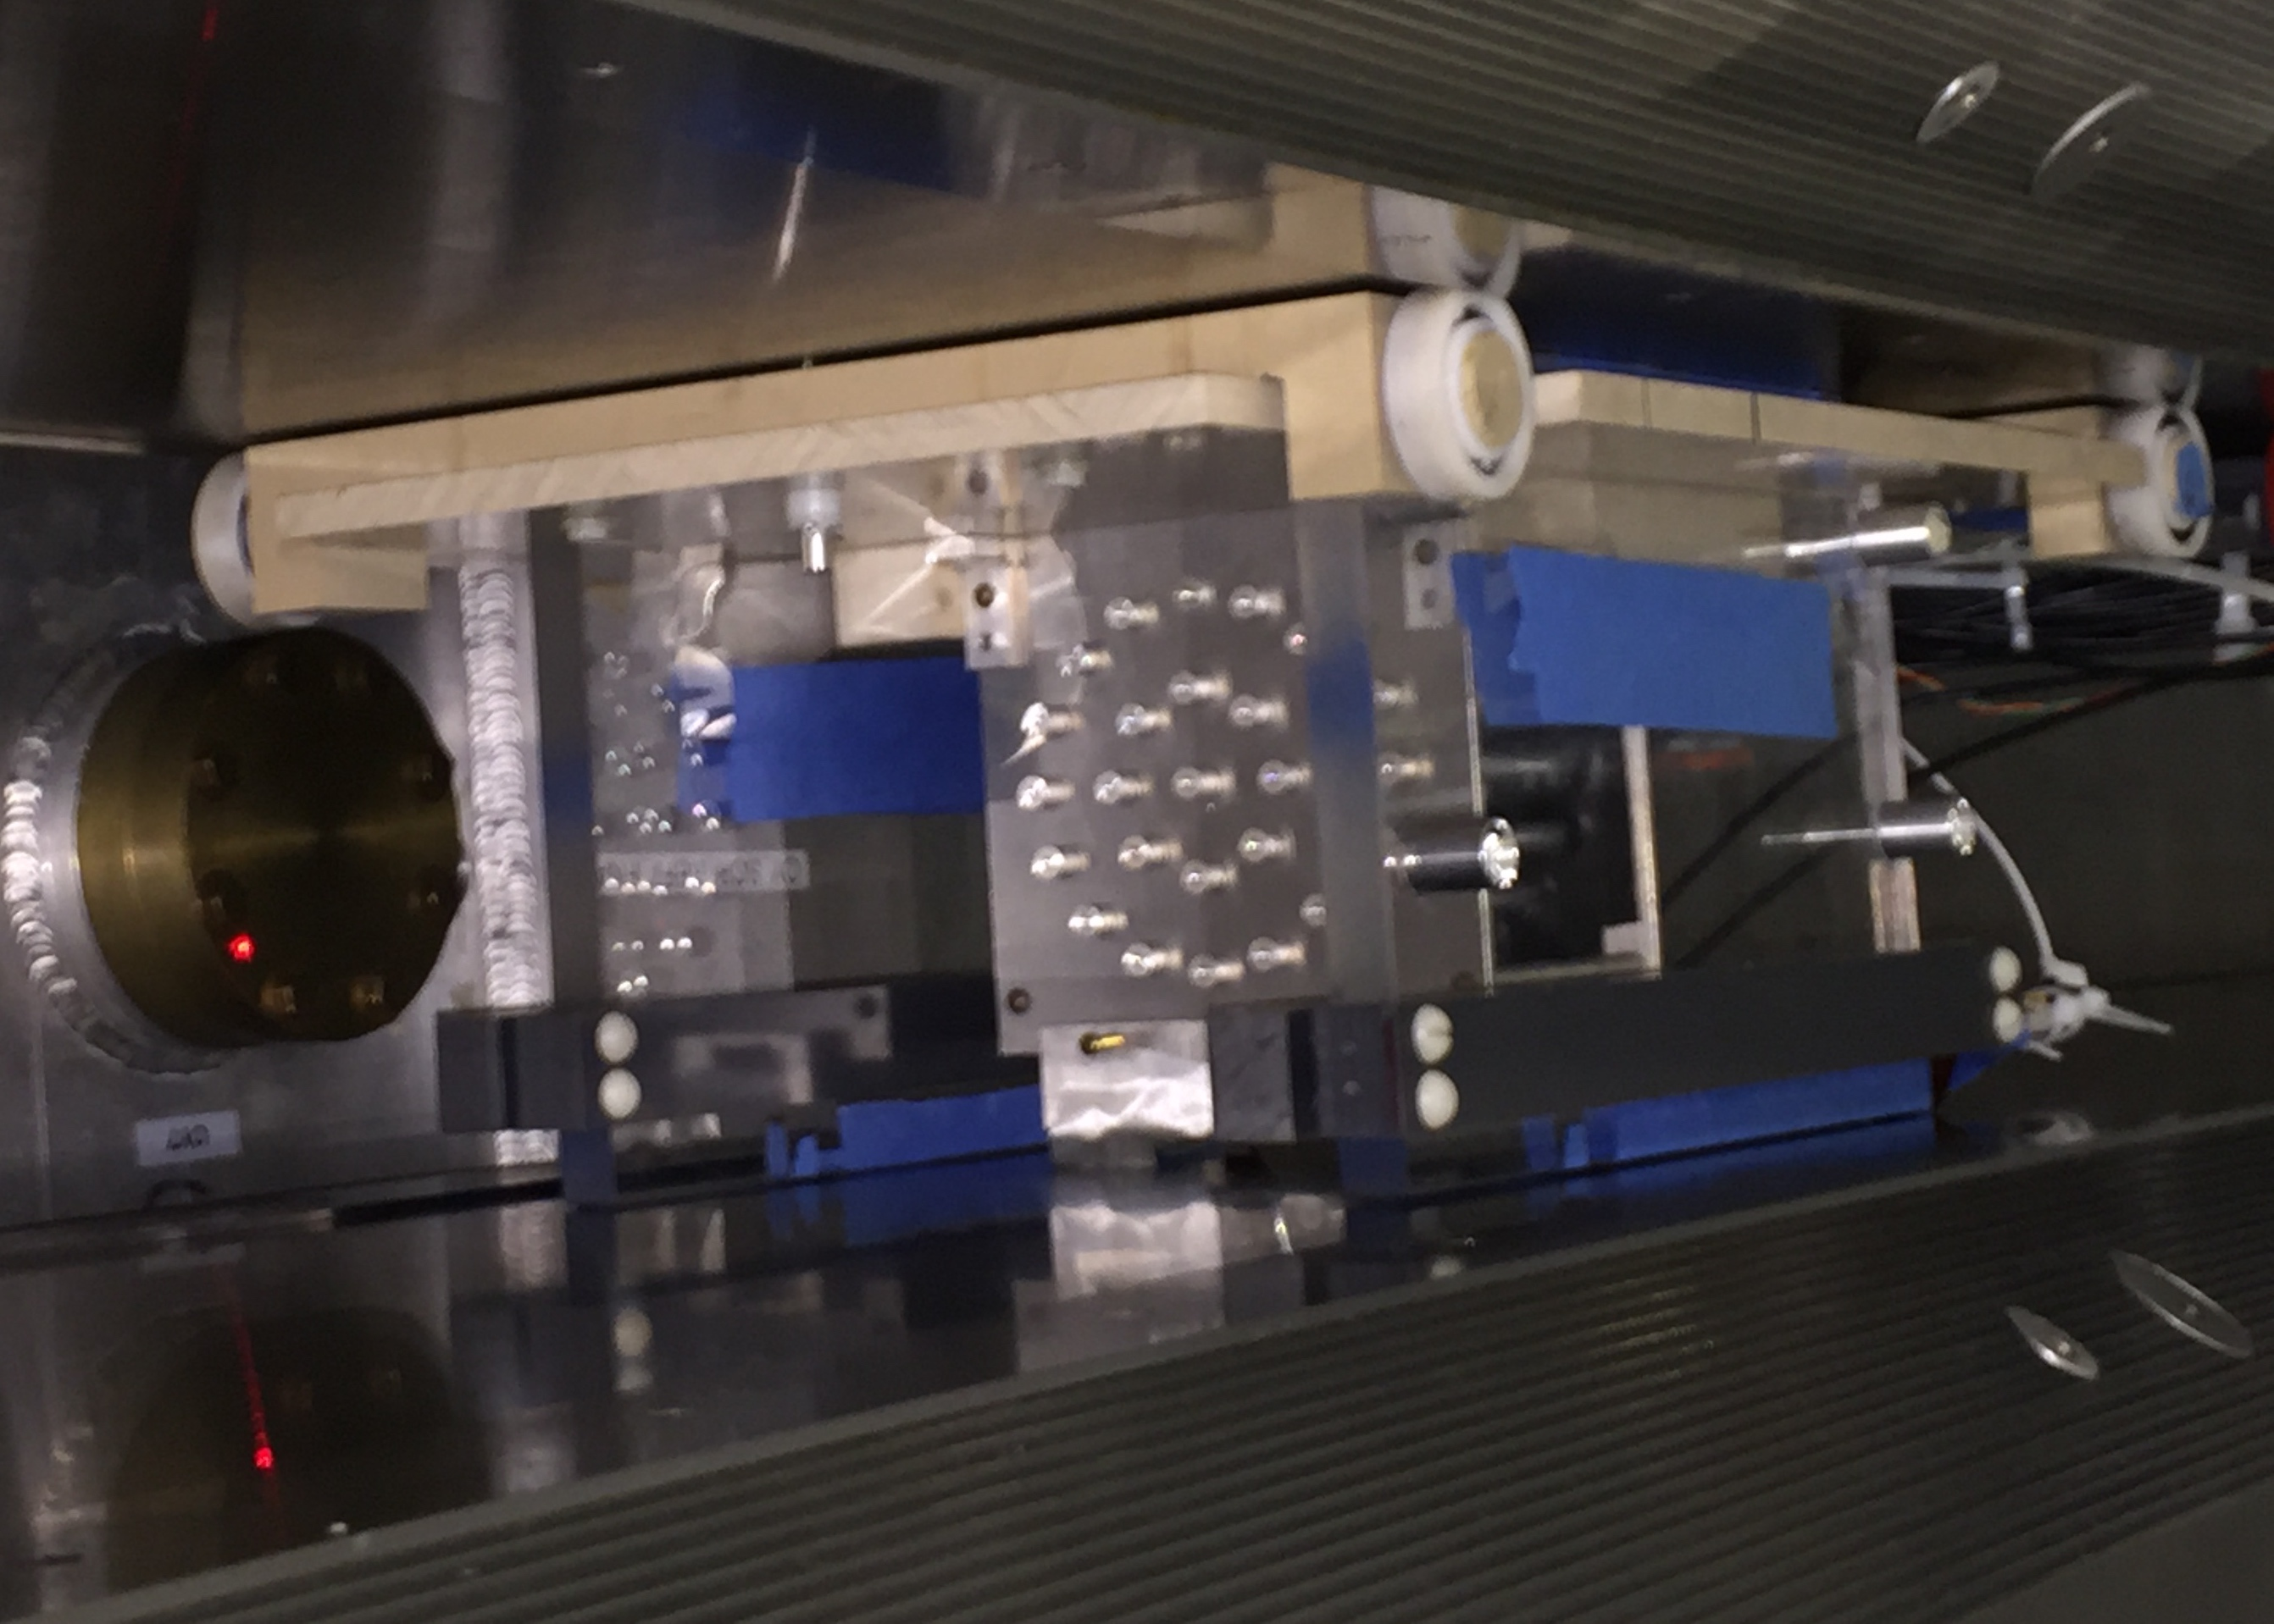
ω_{p} Initial course shiming of the magnet
Use a special trolley
Beating gradients

Slide 19
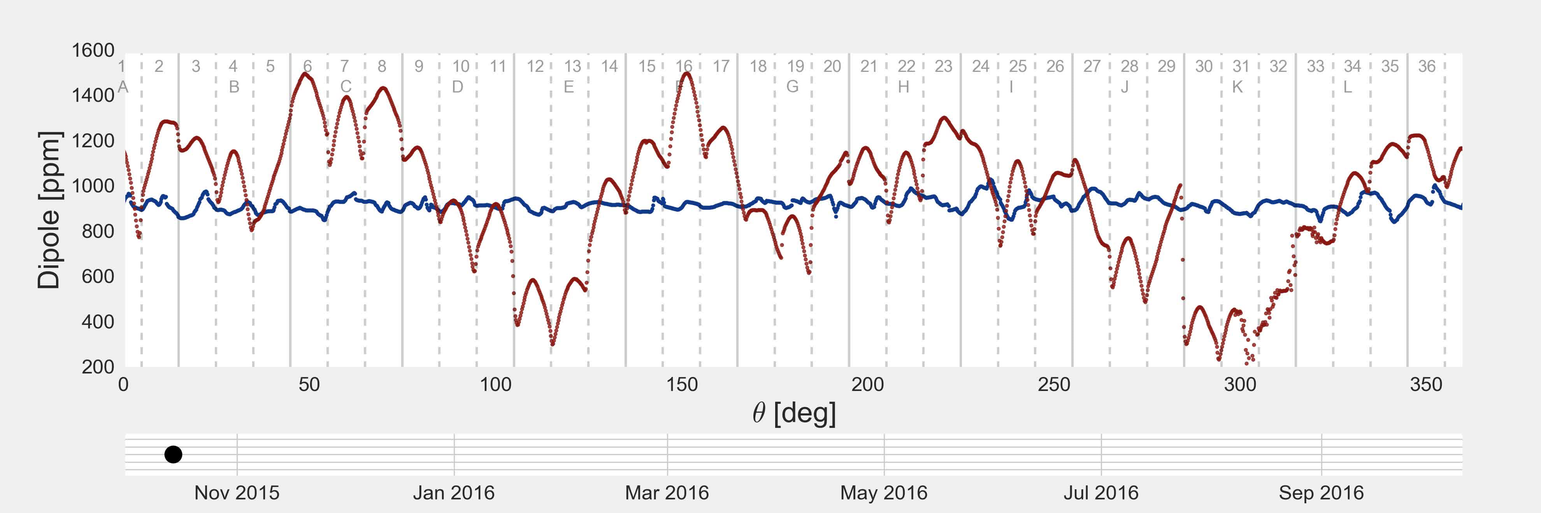
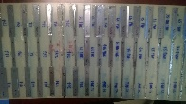
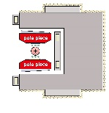
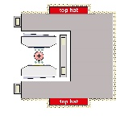
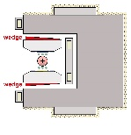
The precision field emerges
Initial dipole field map October 14, 2015 peak variation 1400 ppm
BNL final shimming.
Black dot on bottom plot follows timeline
+

Slide 20
E989 field after shimming
0.5 ppm contours
Central trolley probe vs. azimuth
;
For one value of azimuth, φ
field volume 0.11 m³ or 4 ft³
Fermilab goals:
  point to point uniformity ±25 ppm, rms BNL/3
  average over azimuth even flatter than BNL
  total field error budget 70 ppb

Slide 21
We measure two frequencies: ω_{a} and ω_{p}
The magnetic field is normalized to the Larmor frequency of a free proton.
Spherical absolute calibration probe ties our NMR frequency to the free proton.
We must weight the magnetic field by the muon distribution to obtain
where the fundamental constants are known from other experiments.

Slide 22
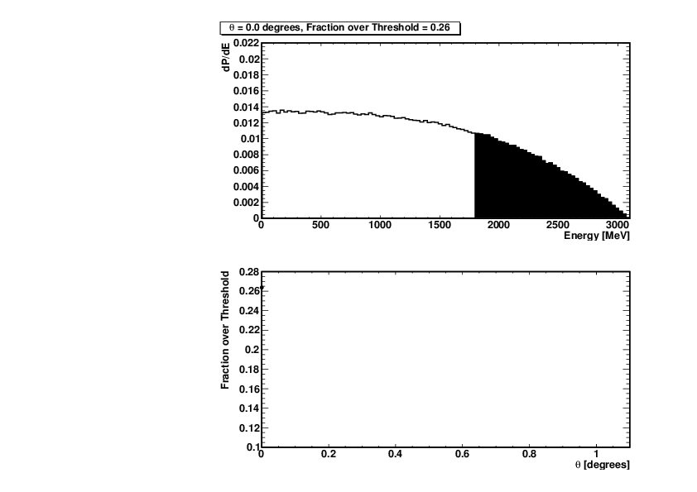
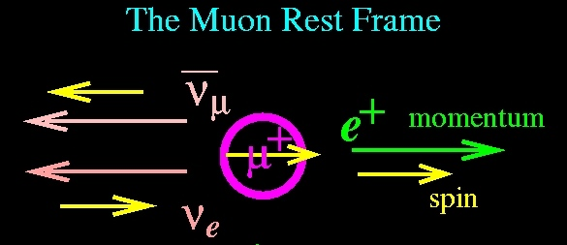
ω_{a}
after 2.2μs Death
Birth
Polarized muons born from pion decay
The highest energy positrons are correlated with muon spin.
As the spin rotates forward and backward the number of e⁺ is modulated by ω_{a}
Energy spectrum
Spin Angle

Slide 23
Experimental Technique
narrow bunch of protons
x_{c} ≈ 77 mm
β ≈ 10 mrad
B·dl ≈ 0.1 Tm
Pions
Inflector
p=3.1GeV/c
Target
(1.45T)
Muon storage ring – weak focusing betatron
Muon polarization
Injection & kicking
Focus with electric quads
24 electron calorimeters (E, t)
Injection orbit
Central orbit
Storage
ring
Kicker
Modules
R=711.2cm
d=9cm
R
R
β
Electric Quadrupoles
x_{c}
B. L. Roberts, Fermilab , 3 September 2008
- p. 23/68
Notes:
23

Slide 24
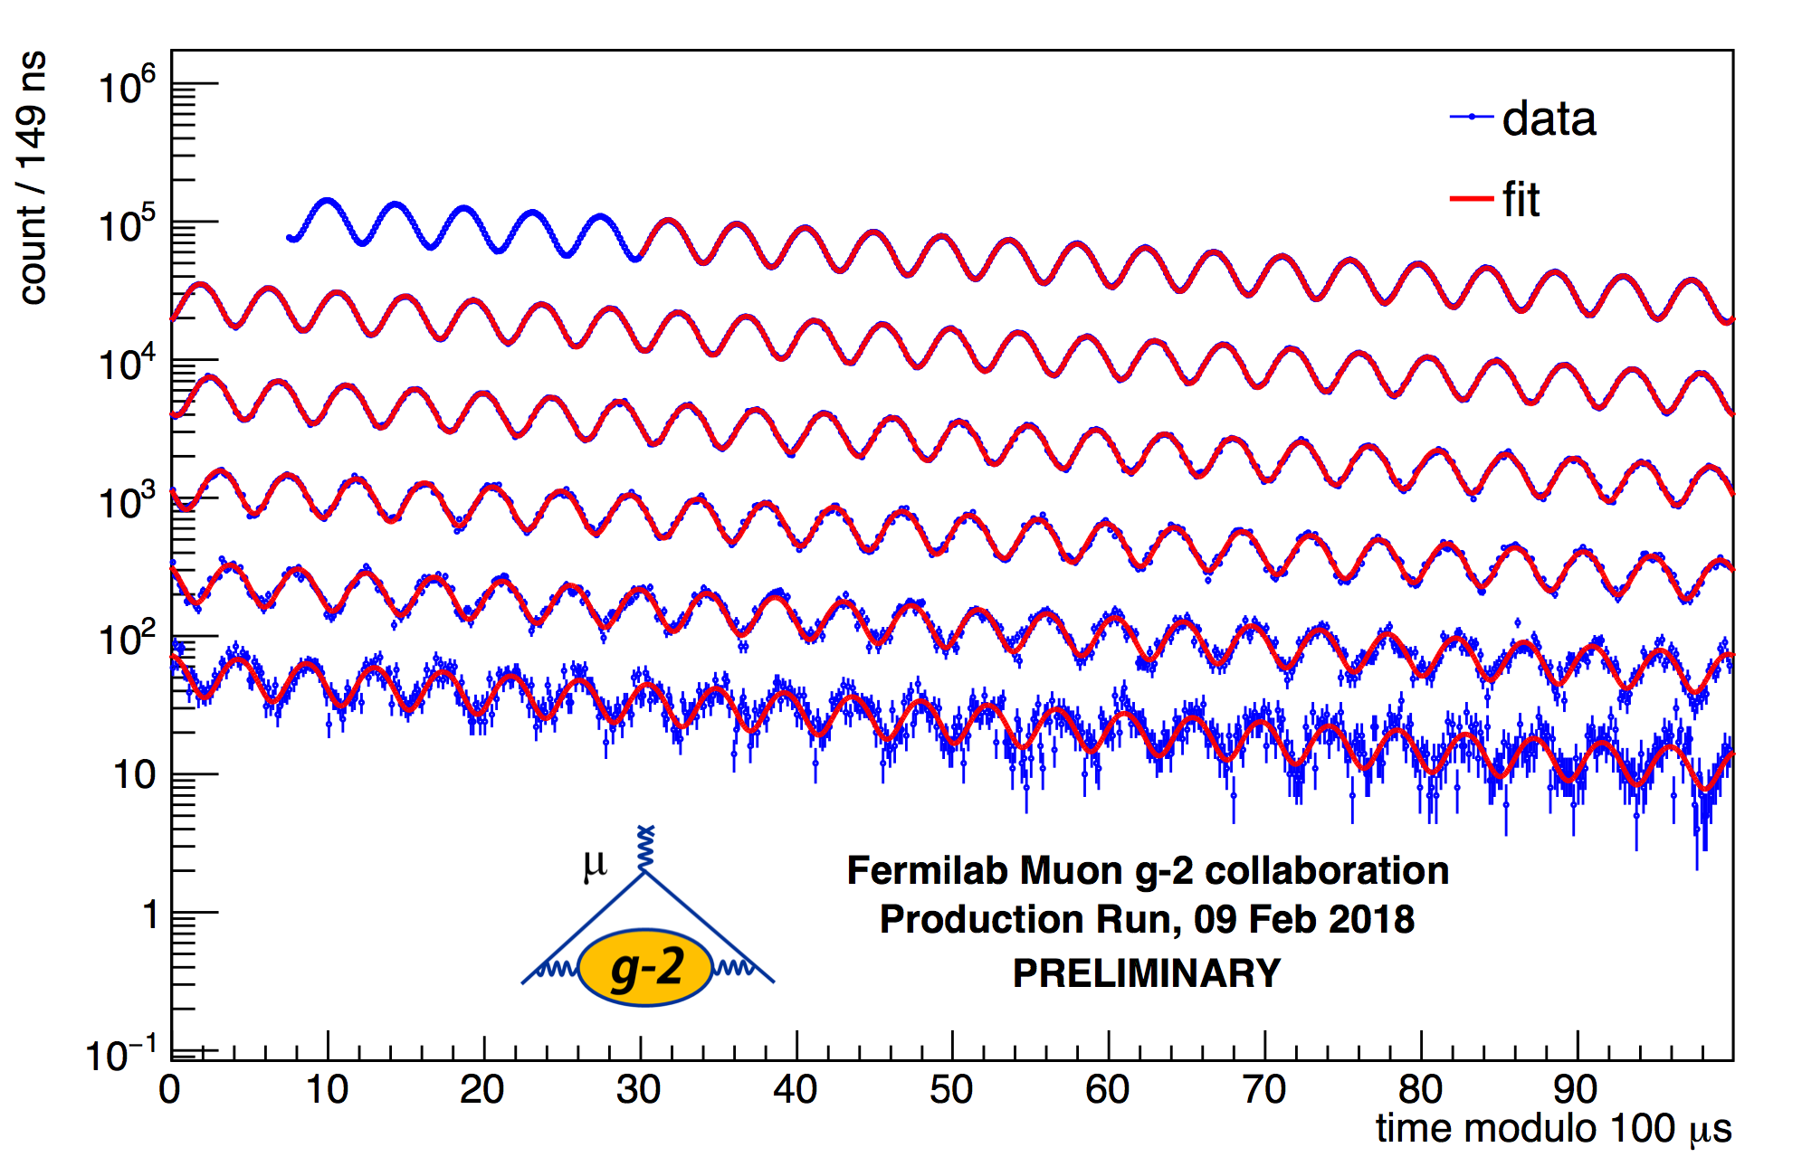
E989 arrival-time spectrum ( ppm)
γτ
0 – 100 μs
100 – 200 μs
200 – 300 μs
300 – 400 μs
400 – 500 μs
500 – 600 μs
Time modulo 100 μs

Slide 25
ω_{a} at Fermilab
New segmented 6 ✕ 9 PbF detectors
  measure E and t.
New custom 800 MHz waveform digitizers
Two stations with straw trackers in front of PbF₂

Slide 26
Full spin difference equation:
we must correct for these terms
  Pitch
  Radial Electric field
Pitch ~0.3 ppm in E821
Radial field ~0.5 ppm in E821.
To calculate them we need the muon distribution

Slide 27
Aside: Spin and Gravity
Proposed correction to the motional magnetic field:
but the value of the motional magnetic field is small
The the relative contribution is:
This should not be a surprise since their calculated correction was twice the EW contribution.
Lesson to theorists: Talk with the experimentalists before you publish.

Slide 28
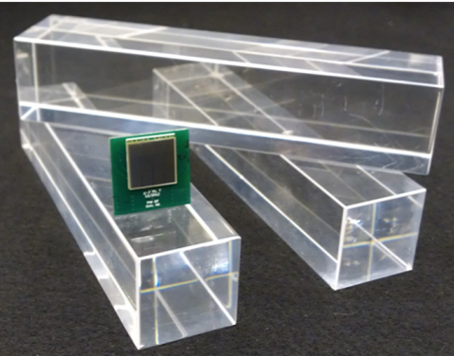
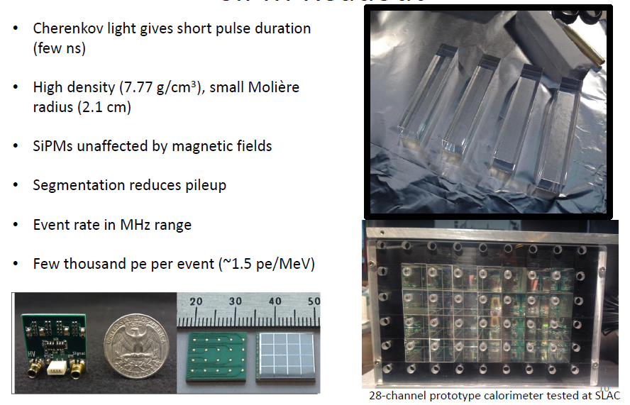
Segmented PbF₂ Calorimeter with SiPM readout
NIM A783(2015)12–21
SiPM boards optimized to produce PMT-like pulses to exploit short pulse duration of Cherenkov crystals (relevant: pileup)
- p. 28

Slide 29
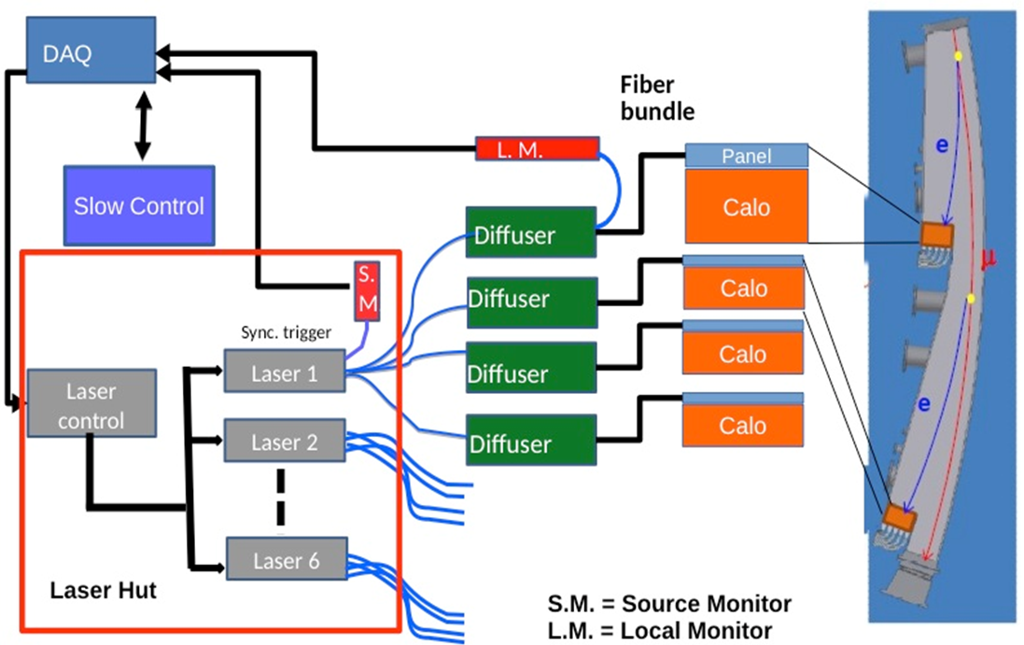
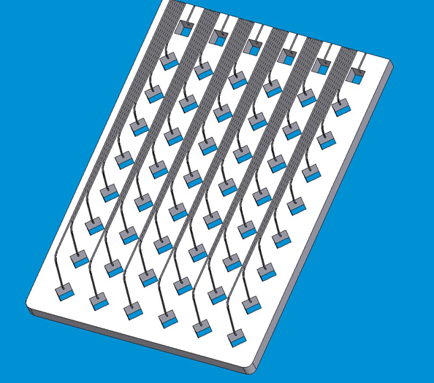
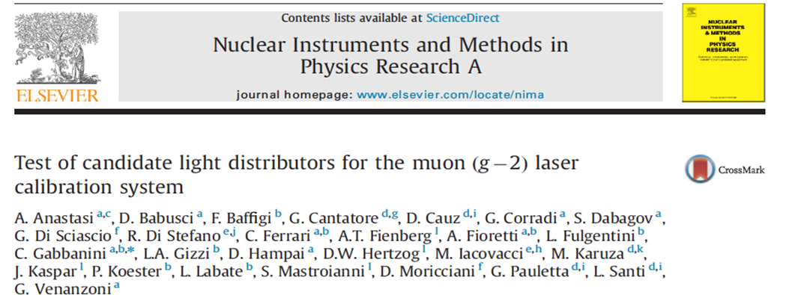
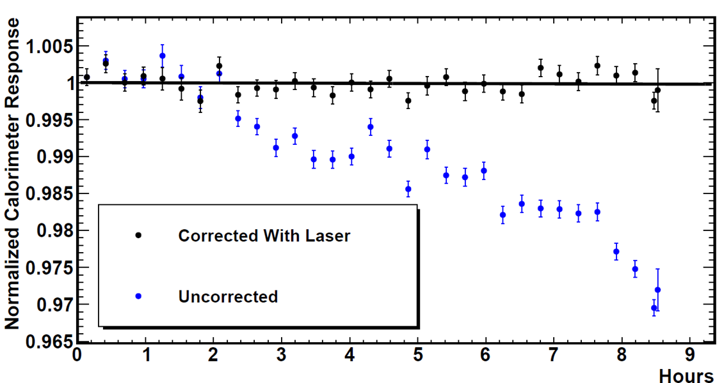
State-of-the-art Laser-based calibration system
Front Panel Prisms
10⁻⁴ / h demonstrated
- p. 29

Slide 30
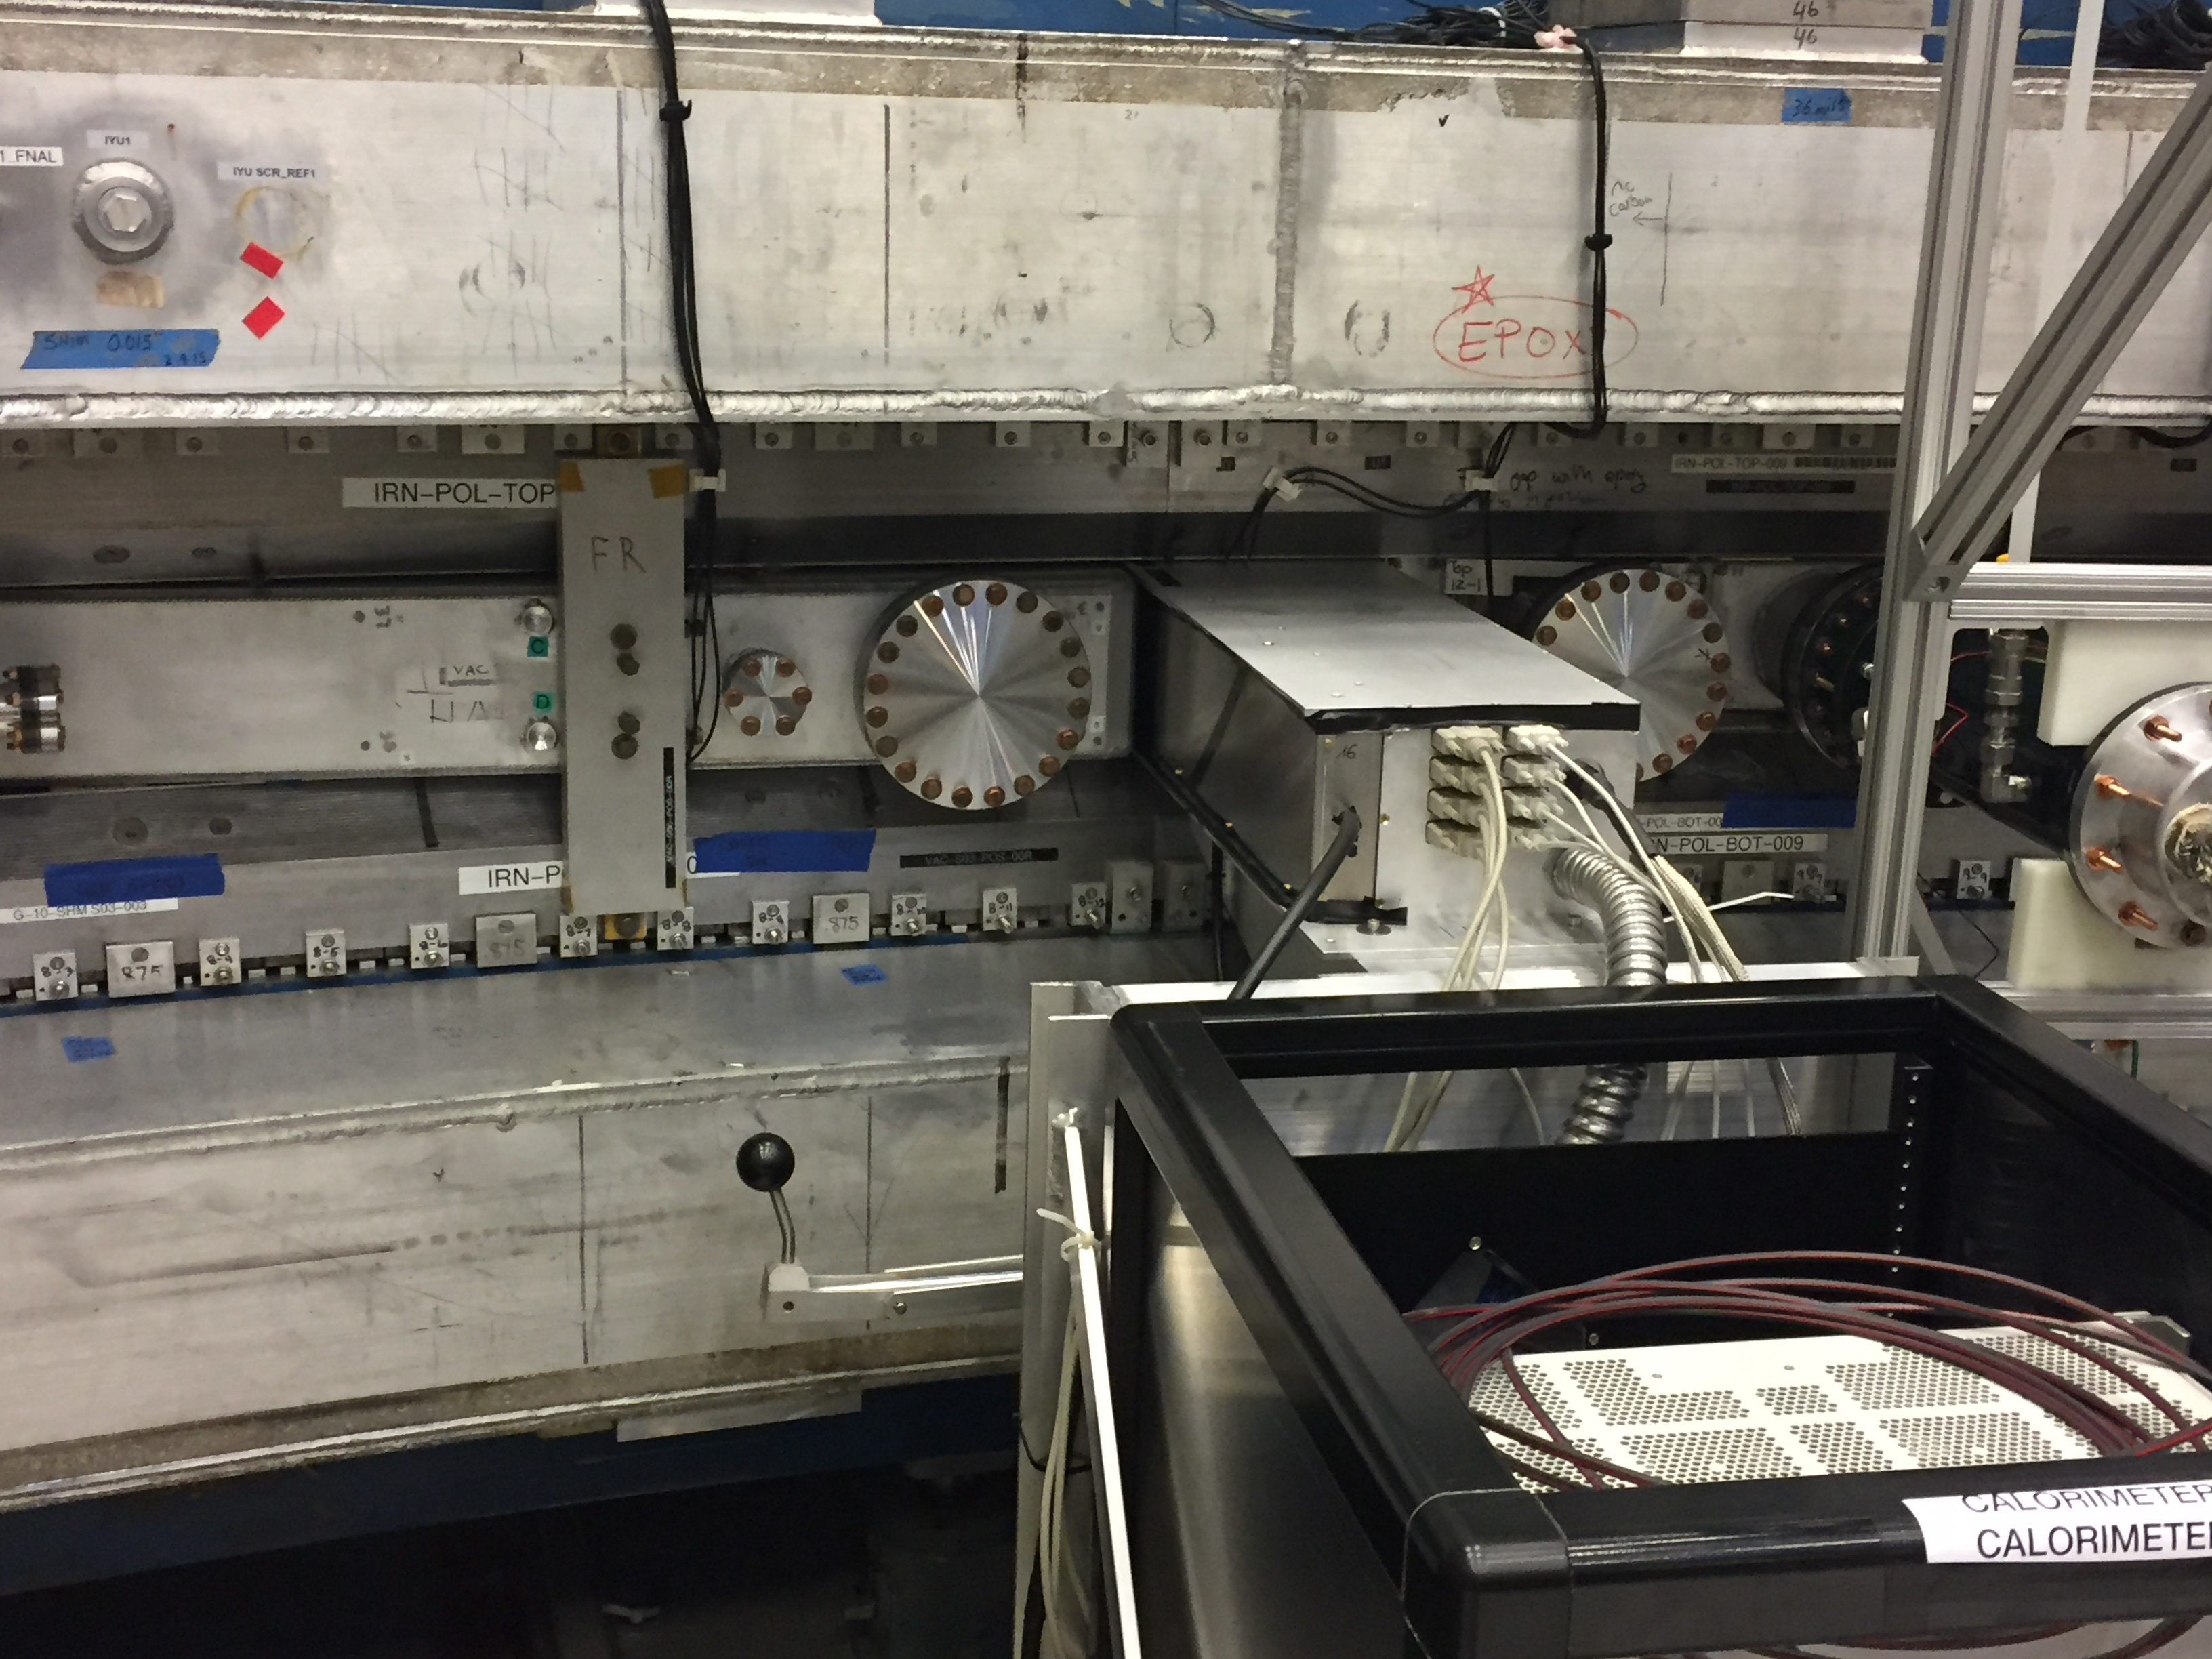
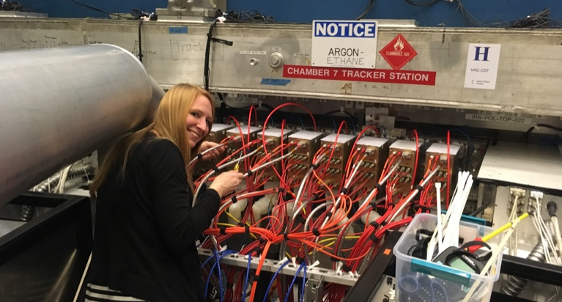
Tracker and caolrimeter: June 2017
Calorimeter
8 Trackers

Slide 31
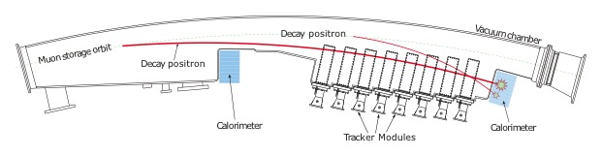
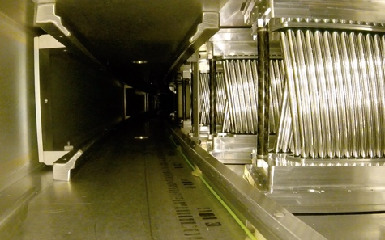

Tracker Design
Each tracker has 8 modules that sit in front of calorimeter
Top down view of ring section
Each module has 128 straws in four layers
Muon’s-eye view inside vacuum chamber
Storage Region
BEAM

Slide 32




Tracker: Momentum & Time
See e⁺ spectrum from μ⁺ decay
After a momentum cut, g-2 oscillation appears
Can also see beam motion frequency in FFT
“Lost” μ⁺
e⁺ from μ⁺ decay
p > 1.8 GeV
g-2
FFT
Beam Oscillation

Slide 33


Tracker: Beam Distribution
Extrapolate tracks back to point of tangency to get beam distribution:
Decay Vertices
Radial & Vertical Position
r_{magic} – 5 cm
2/3 trackers installed & operational

Slide 34

Where could a _{μ} be at the end of E989?
With 2×10¹¹ analyzed events above 1.8 GeV
  total data “several petabytes”
Experiment ± 140 ppb (±16 × 10⁻¹¹) or better
Theory ± 306 ppb (±35 × 10⁻¹¹) or better
Δ = (274 ± 38) × 10⁻¹¹
> 7 σ
Blum, et al.,
arXiv:1311.2198v1 [hep-ph] 9 Nov 2013

Slide 35
Final Comments
This is very much a work in progress.
Goals
  before the 2018 summer shutdown we hope to have one to two times the BNL data set
  the next data set σ_{BNL} ÷ 2
  Final result σ_{BNL} ÷ 4

Slide 36


g = 2( … + C₃(α/π)³ + C₄(α/π)⁴+ Had + Weak + ? )
g = 2( … + C₃(α/π)³ + Had)
g = 2( … + C₃(α/π)³ + Had)
g = 2(1 + α/2π + C₃(α/π)³ )
g = 2(1 + α/2π)

Slide 38

Systematic Errors on ω_{a} (ppb)

Slide 39

Errors from BNL and projected at Fermilab

Slide 40


Tracker: Beam Dynamics
    Use same data to measure position and width changes from beam oscillation
Radial Position within Fill
Mean & RMS of Radial Position

Slide 41





Electric Dipole Moment: P T
Transformation Properties
If CPT is valid, the T violation of an EDM would imply non-standard model CP. Of course, we need new sources of CP to explain why we’re here.

Slide 42
The Muon EDM would modify the precession.
A muon EDM would modify the spin equation
the motional electric field will dominate, so the precession plane is tilted.

Slide 43

The spin is tipped all around the ring

Slide 44
Advantage of tracking
tracking: look for an oscillation of upward, then downward going tracks, + π/2 phase relative to ω_{a}.
Spin is tipped at every point around the ring.
Furthermore, the figure of merit is advantageous for d_{μ}, in that it peaks lower as shown on the next slide

Slide 45
The Muon EDM would modify the precession.
Frozen Spin
A muon EDM would modify the spin equation
the motional electric field will dominate, so the precession plane is tilted.
An up-down oscillation out of phase
with ω_{a}.
0

