Slide 1
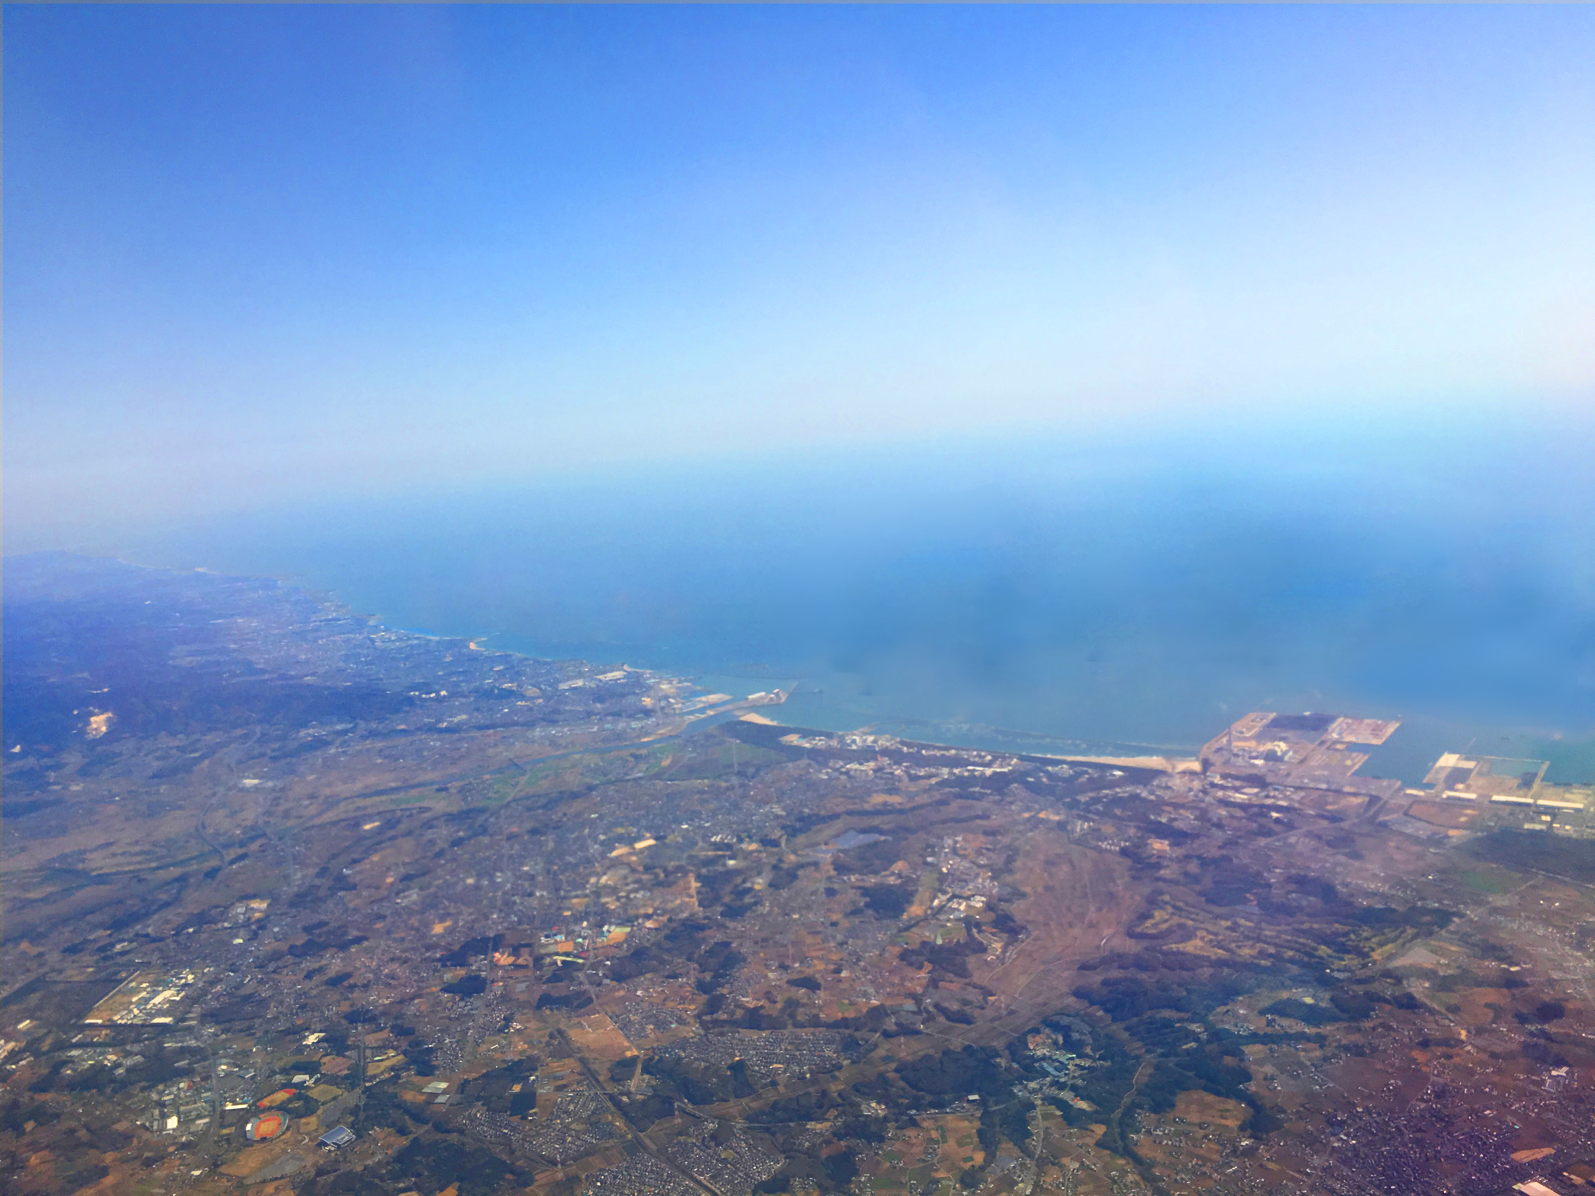
Updates on muon g-2/EDM experiment at J-PARC
March 13, 2018
Tsutomu Mibe (KEK)
www.g-2.kek.jp

Slide 2
Summary
The HVP workshop at KEK was a big success!
We have completed major part of homework assigned by PAC and the TDR review committee (FRC).
In addition, we have made major progress
Data on thermal muonium production taken at TRIUMF
First muon acceleration to 90 keV
Cross calibration of NMR probe in 20 ppb (8 digits)
Test of a thin beam monitor at J-PARC
Mu-HFS data taking with the “g-2 silicon detector” (MuSEUM)
In coming years,
Construction of muon beamline (H-line)
Demonstration of “muon cooling”
Re-acceleration to 1 MeV
Results from the MuSEUM experiment

Slide 3
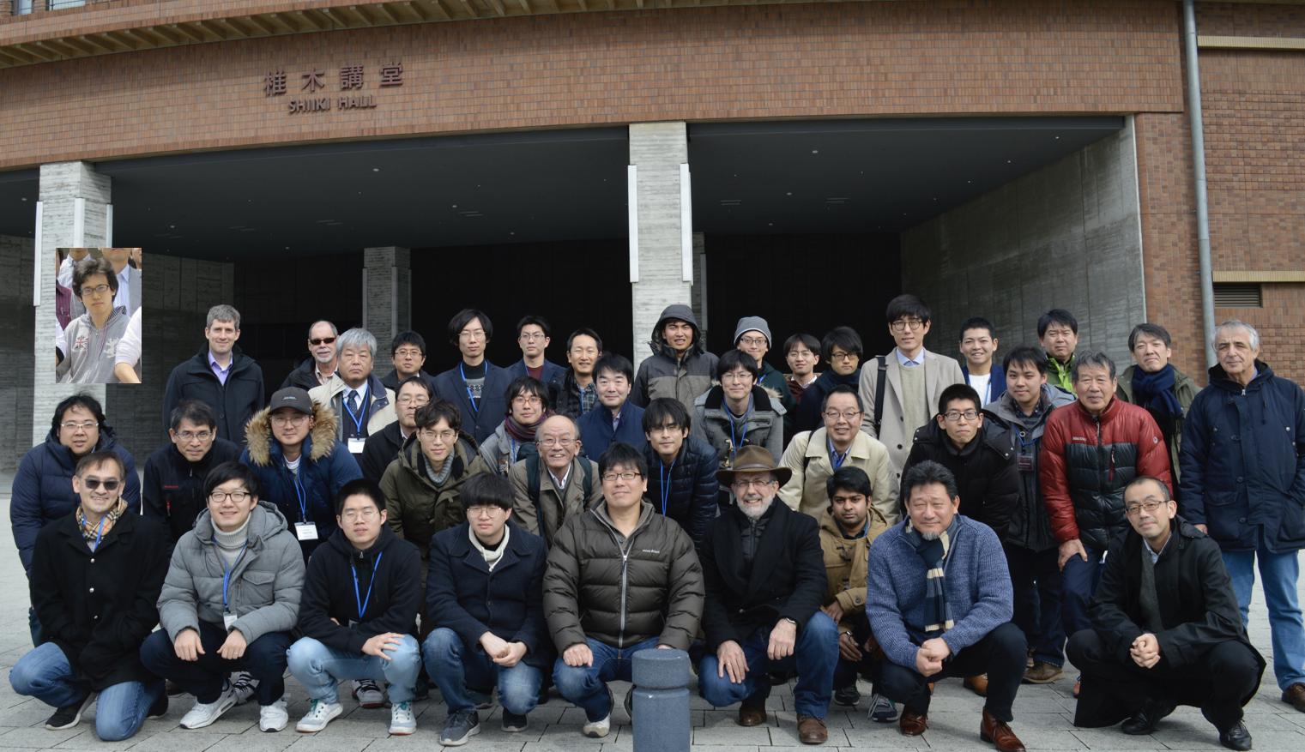

The Collaboration
92 “current” members from 40 institutions
signed up for the collaboration bylaws (2017)
Collaboration meeting in Kyushu University
(December, 2017)

Slide 4
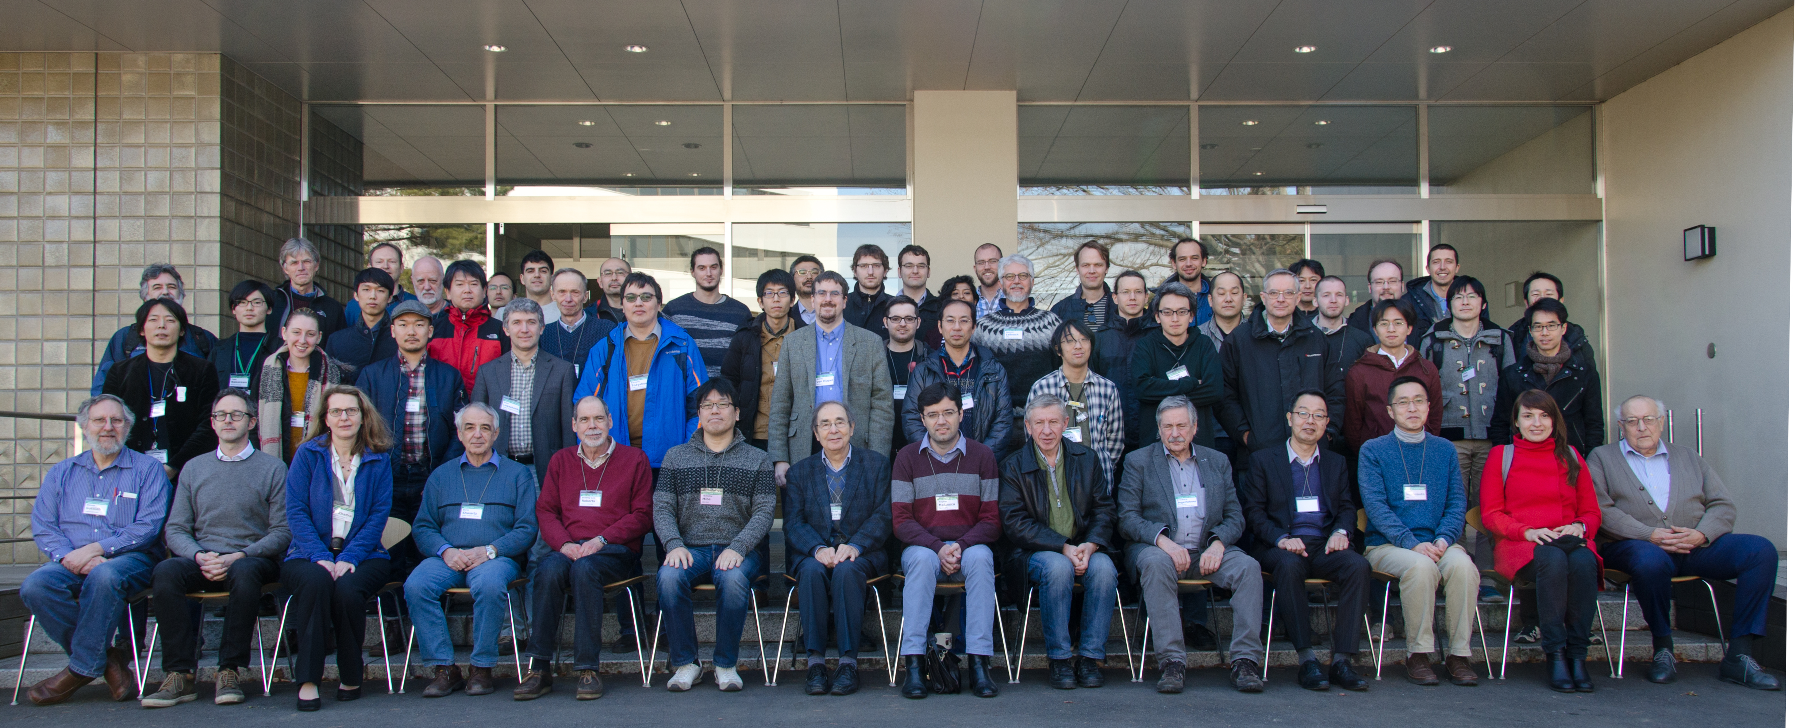
Hadronic vacuum polarization WS at KEK in Feb 12-14, 2018
http://www-conf.kek.jp/muonHVPws/index.html
KEK, Feb 2018
70 participants from theory and experimental communities
including the Belle II experiment.

Slide 5
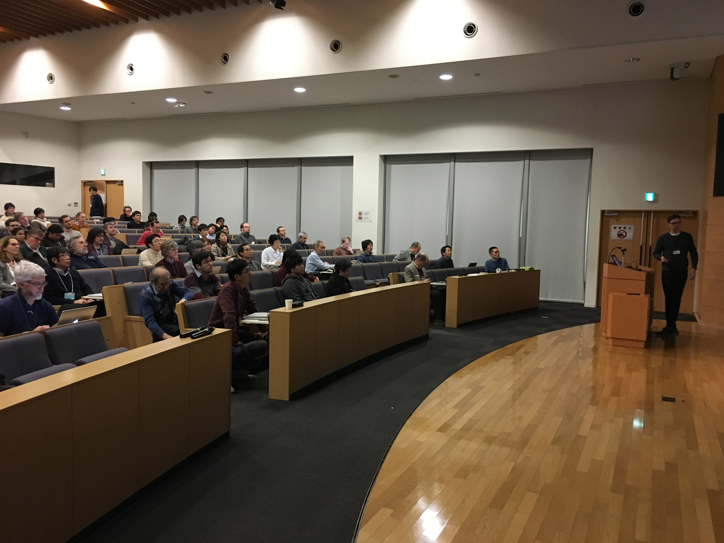

Slide 6
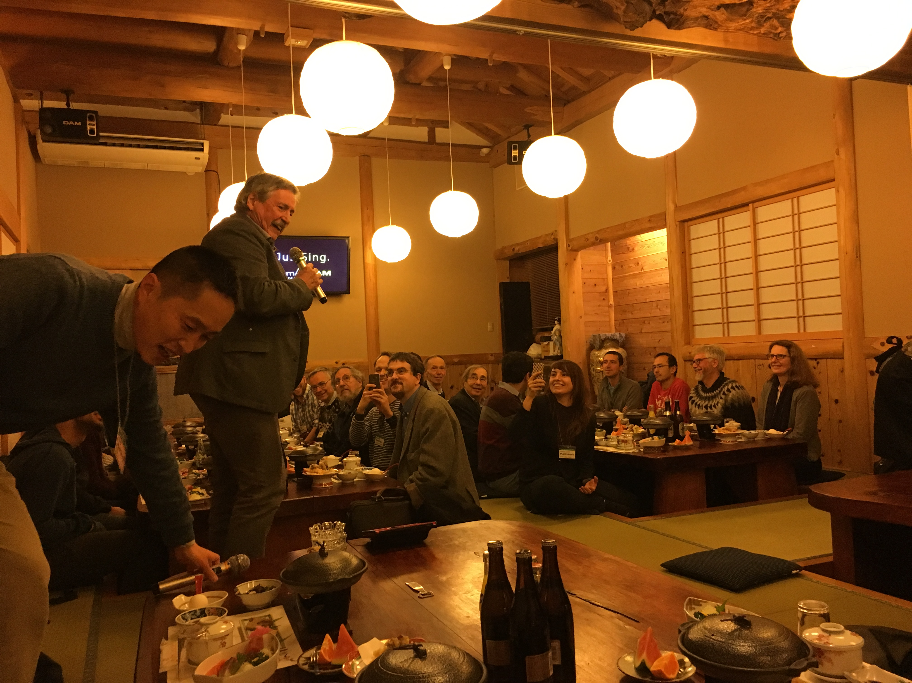
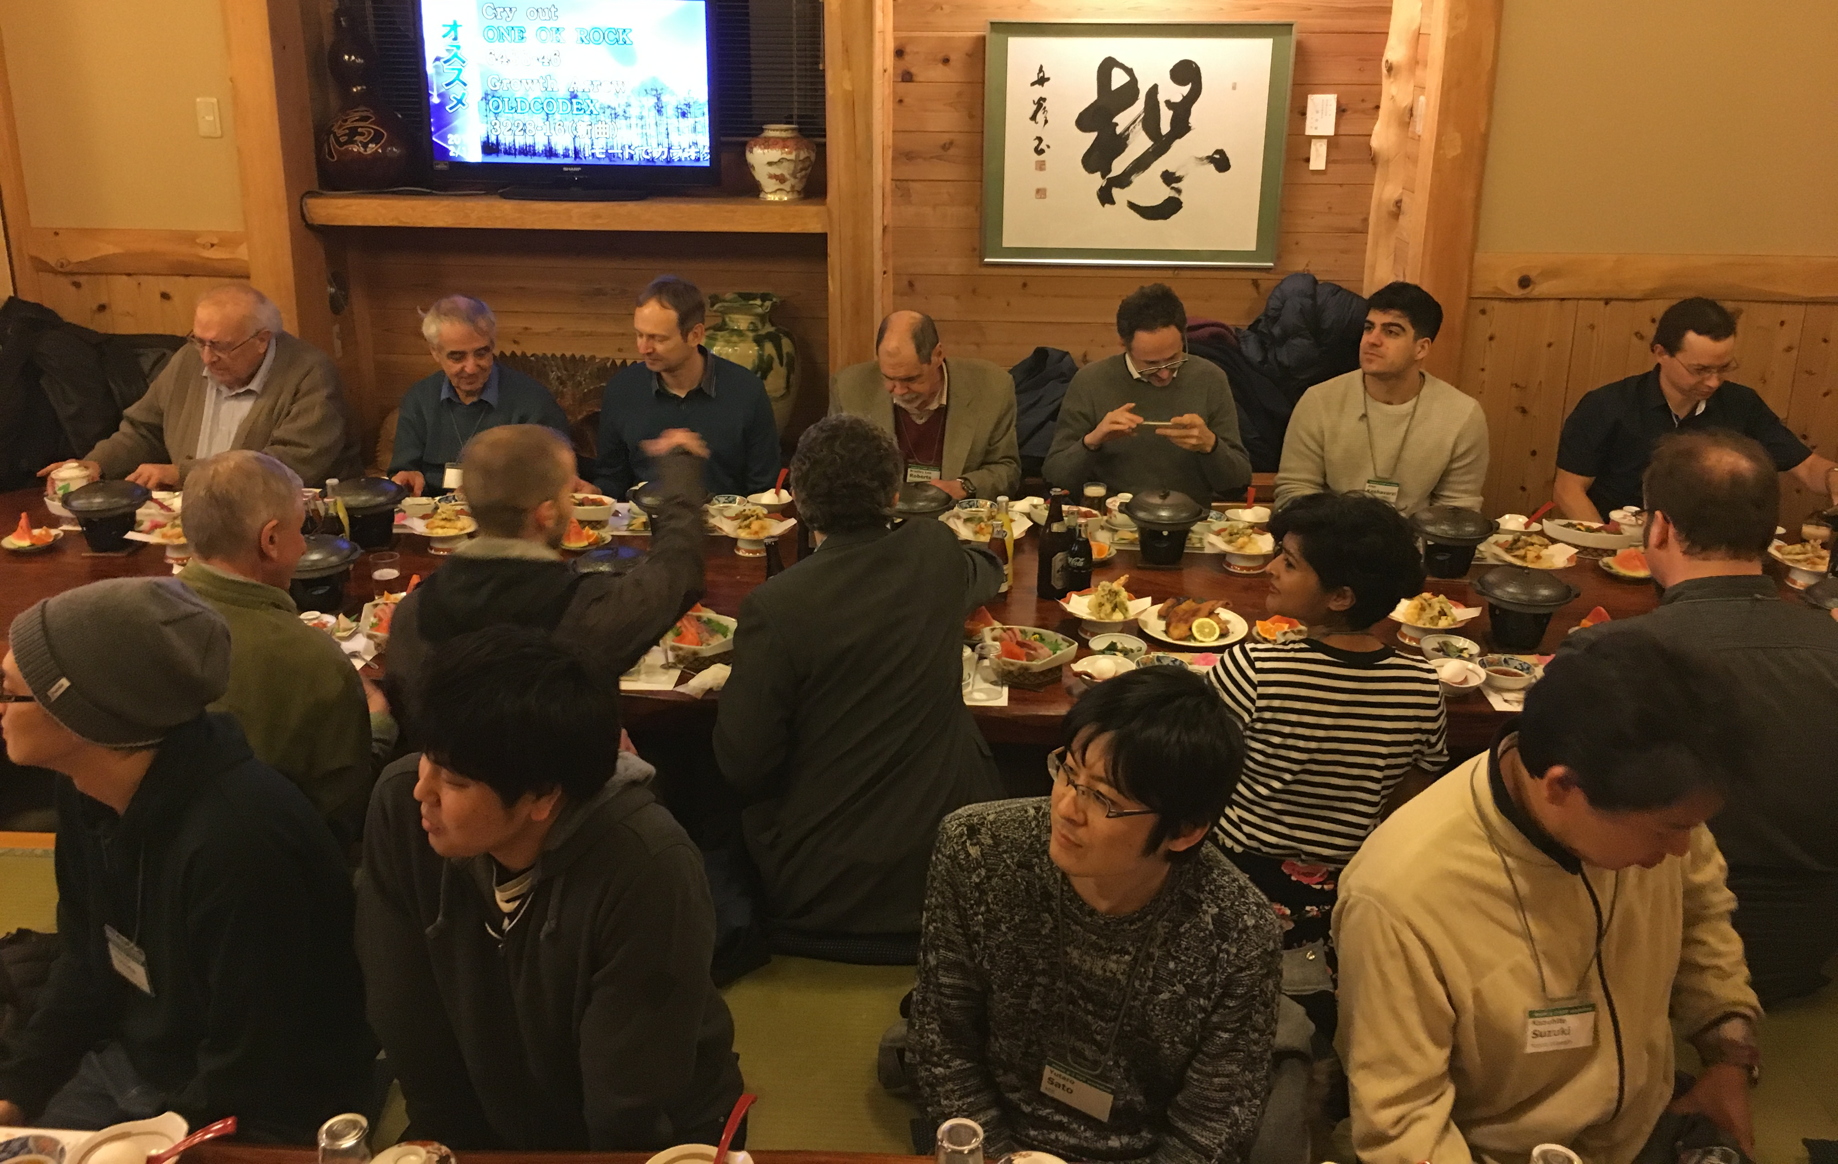

Slide 7
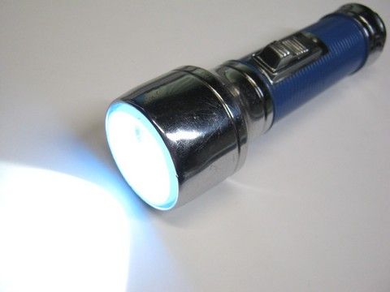
Muon beam at BNL/FNAL
Conventional muon beam
proton
π⁺
μ⁺
emittance
~1000π mm・mrad
pion
production
Strong focusing
Muon loss
BG π contamination
decay

Slide 8
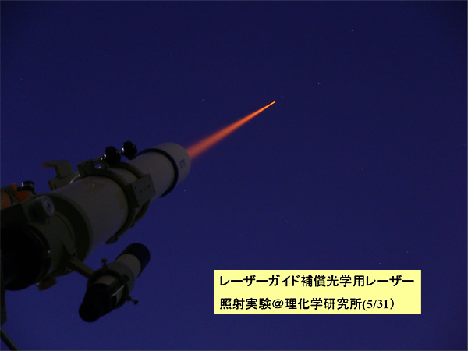
Muon beam at J-PARC
Conventional muon beam
proton
π⁺
μ⁺
emittance
~1000π mm・mrad
pion
production
Strong focusing
Muon loss
BG π contamination
decay
cooling
μ⁺
emittance
1π mm・mrad
Ultra-cold
muon beam
Free from any of these

Slide 9
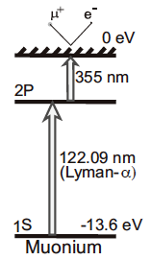
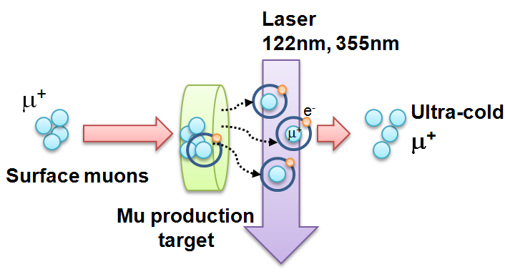
Ultra-cold Muon
Requirement for zero E-field:
Muons should be kept stored without E-focusing
→ Beam with ultra-small transverse dispersion,
i.e. Δp_{T}/p ~0
Laser resonant ionization of Mu (μ⁺e⁻)
re-acceleration
p =
28MeV/c
3 keV/c
300 MeV/c
Δp_{T}/p ~3 keV / 300 MeV =1E-5

Slide 10
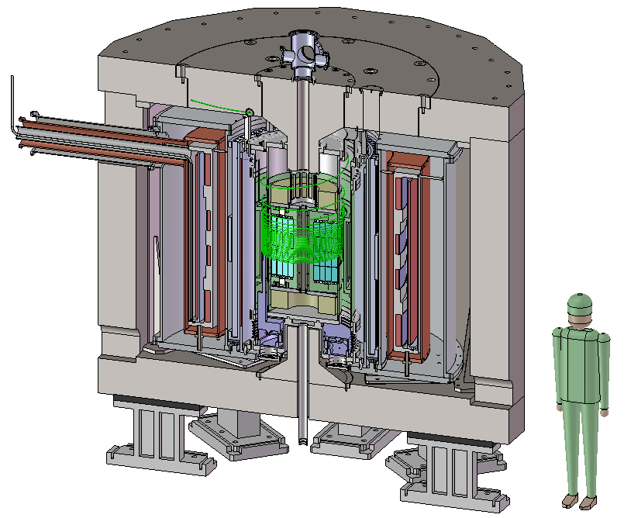
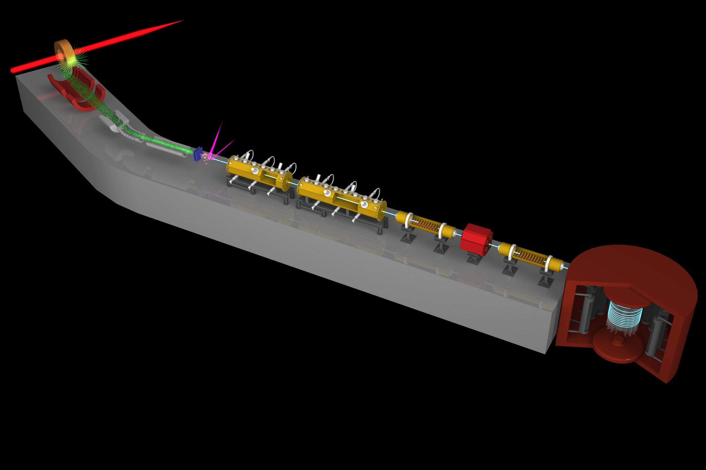
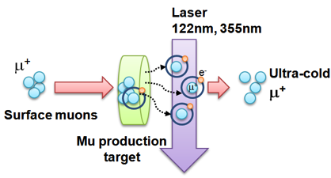
Muon g-2/EDM Experiment at
J-PARC with Ultra-Cold Muon Beam
Silicon
Tracker
3 GeV proton beam
( 333 uA)
Production target
(20 mm)
Surface muon beam
(28 MeV/c)
Muonium Production
(300 K ~ 25 meV⇒2.3 keV/c)
66 cm
Surface muon
Super Precision Storage Magnet
(3T, ~1ppm local precision)
Ultra Cold μ+ Source
Muon
storage
Resonant Laser Ionization of Muonium (~10⁶ μ⁺/s)
Muon LINAC (300 MeV/c)
Δ(g-2) = 0.1 ppm
ΔEDM = 10⁻²¹ e・cm

Slide 11
Experimental sequence
40ms (25 Hz)
Surface
muon beam
(28 MeV/c)
μ⁺
laser ionization
Mu
Thermal
muonium
(3keV/c)
~1μs
μ⁺
~1ns
Ultra-slow muon
(3keV/c)
μ⁺
~3ns
Acceleration + injection
(300 MeV/c)
40 μs
Storage and detection
(300 MeV/c)
μ⁺→e⁺

Slide 12
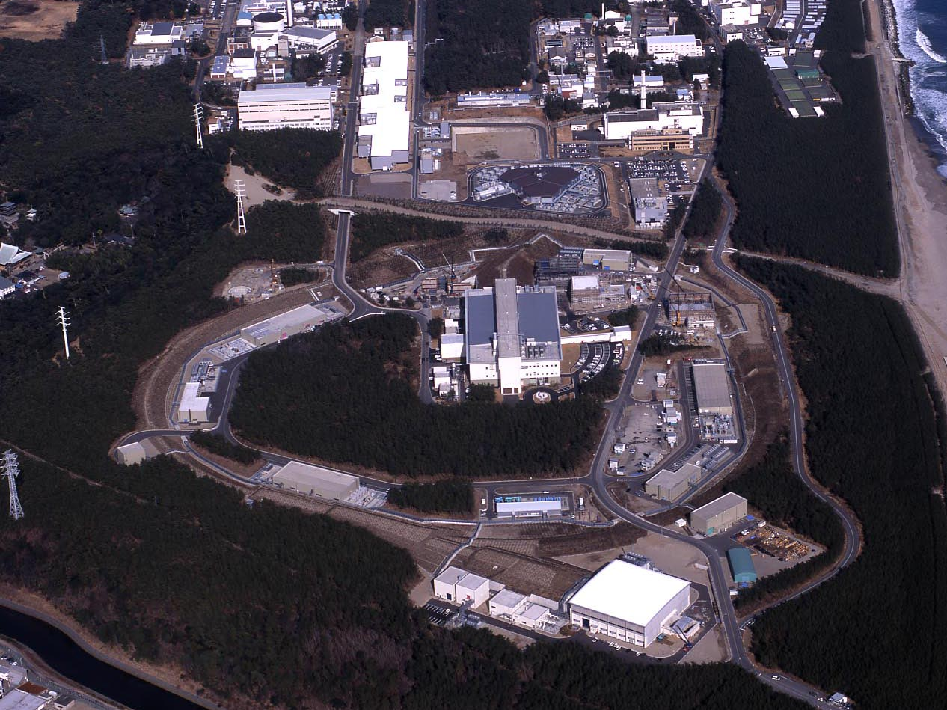
J-PARC Facility
(KEK/JAEA)
LINAC
3 GeV
Synchrotron
Neutrino Beam
To Kamioka
Material and Life Science
Facility
Main Ring
(30 GeV)
Hadron Hall
Bird’s eye photo in Feb. 2008

Slide 13
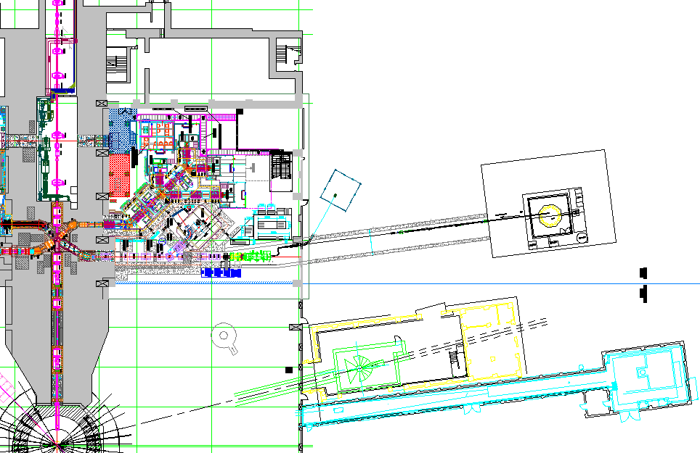
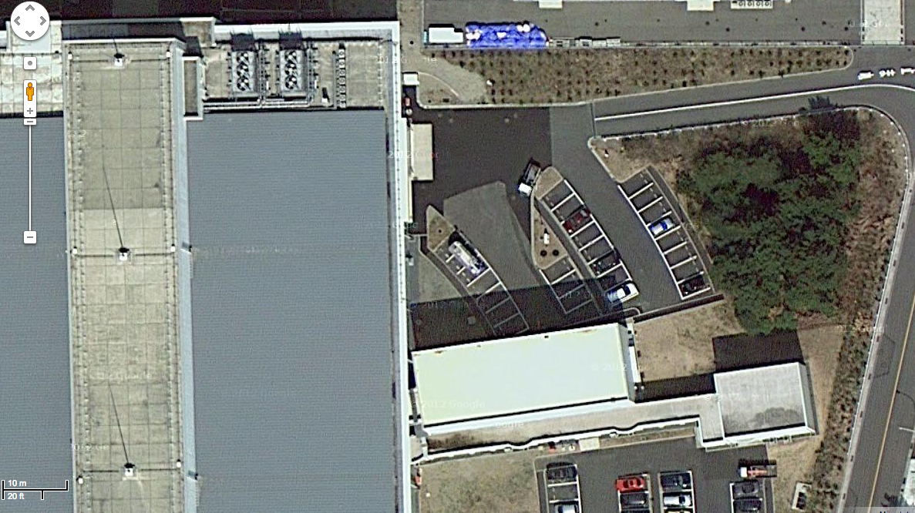
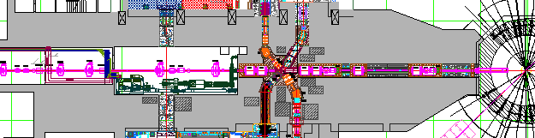
Proposed experimental site
Material and Life science Facility in J-PARC
New Electric
Power substation
Parking lot
g-2/EDM
storage magnet
H-Line
muon linac
muon
production
target
MuSEUM
DeeMe
sparation neutron
source

Slide 14
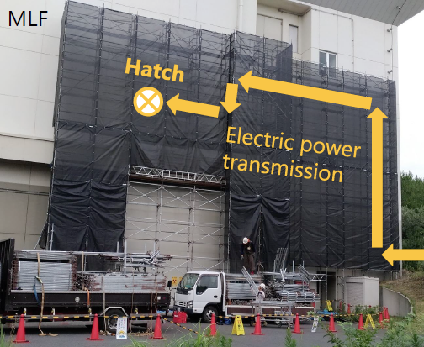
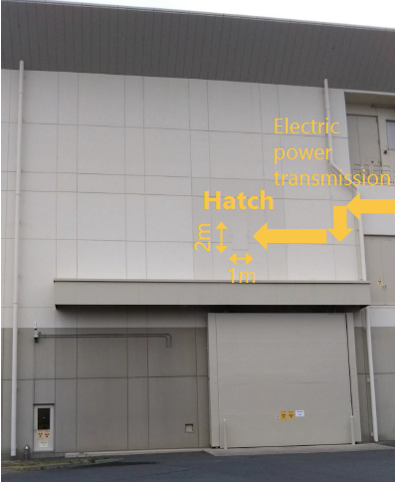
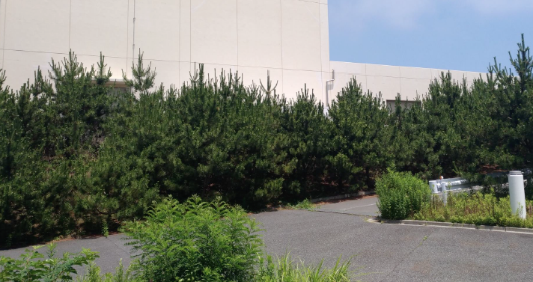
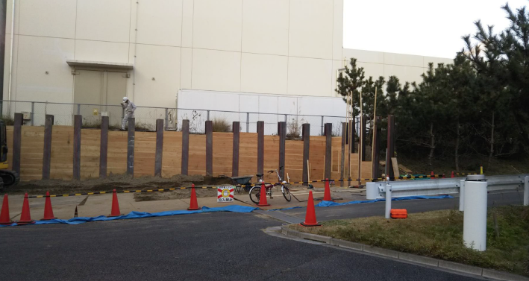
New electric sub-station for H-line
Cabling hole on the wall
Pictures by T. Yamazaki
Bedding for the sub-station

Slide 15
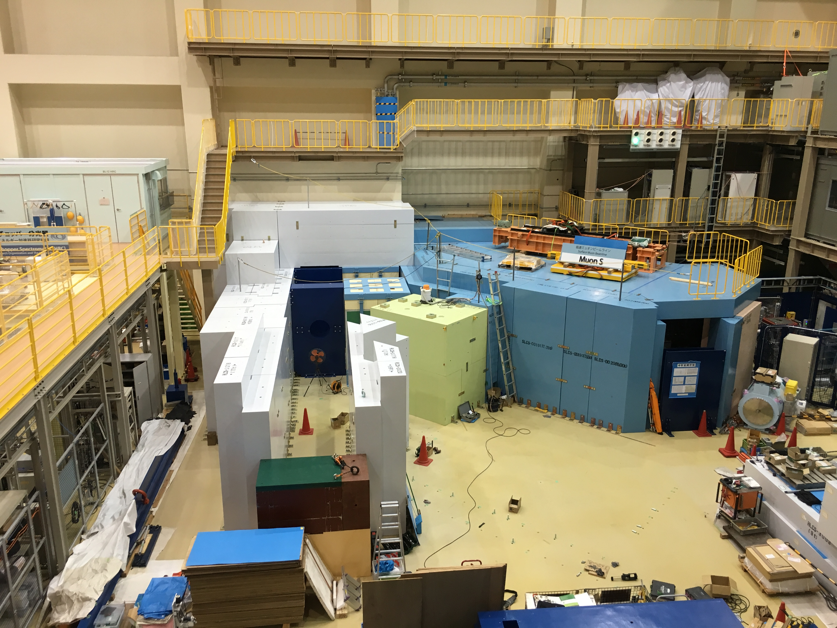
2016.8.17

Slide 16
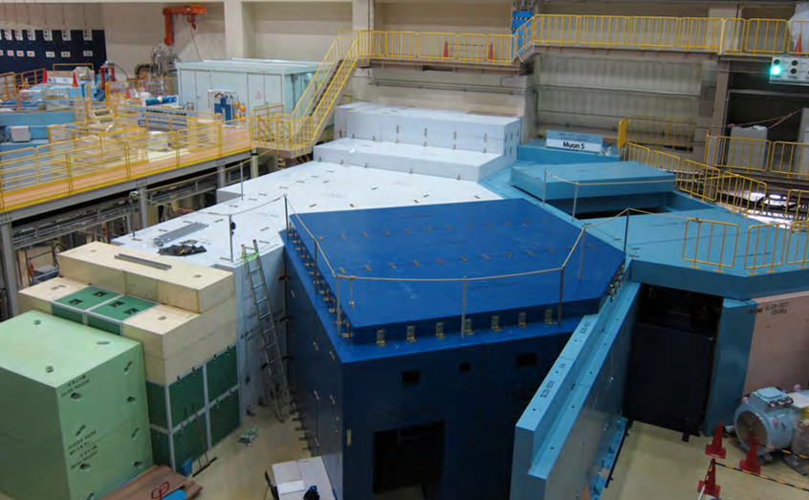
surface muon
branch
mu LINAC
MuSEUM (Mu-HFS, μ_{μ}/μ_{p})
DeeMe (mu-e conv.)

Slide 17
Muon g-2/EDM Experiment at
J-PARC with Ultra-Cold Muon Beam
Silicon
Tracker
3 GeV proton beam
( 333 uA)
Production target
(20 mm)
Surface muon beam
(28 MeV/c)
Muonium Production
(300 K ~ 25 meV⇒2.3 keV/c)
66 cm
Surface muon
Super Precision Storage Magnet
(3T, ~1ppm local precision)
Ultra Cold μ+ Source
Muon
storage
Resonant Laser Ionization of Muonium (~10⁶ μ⁺/s)
Muon LINAC (300 MeV/c)
Δ(g-2) = 0.1 ppm
ΔEDM = 10⁻²¹ e・cm

Slide 18
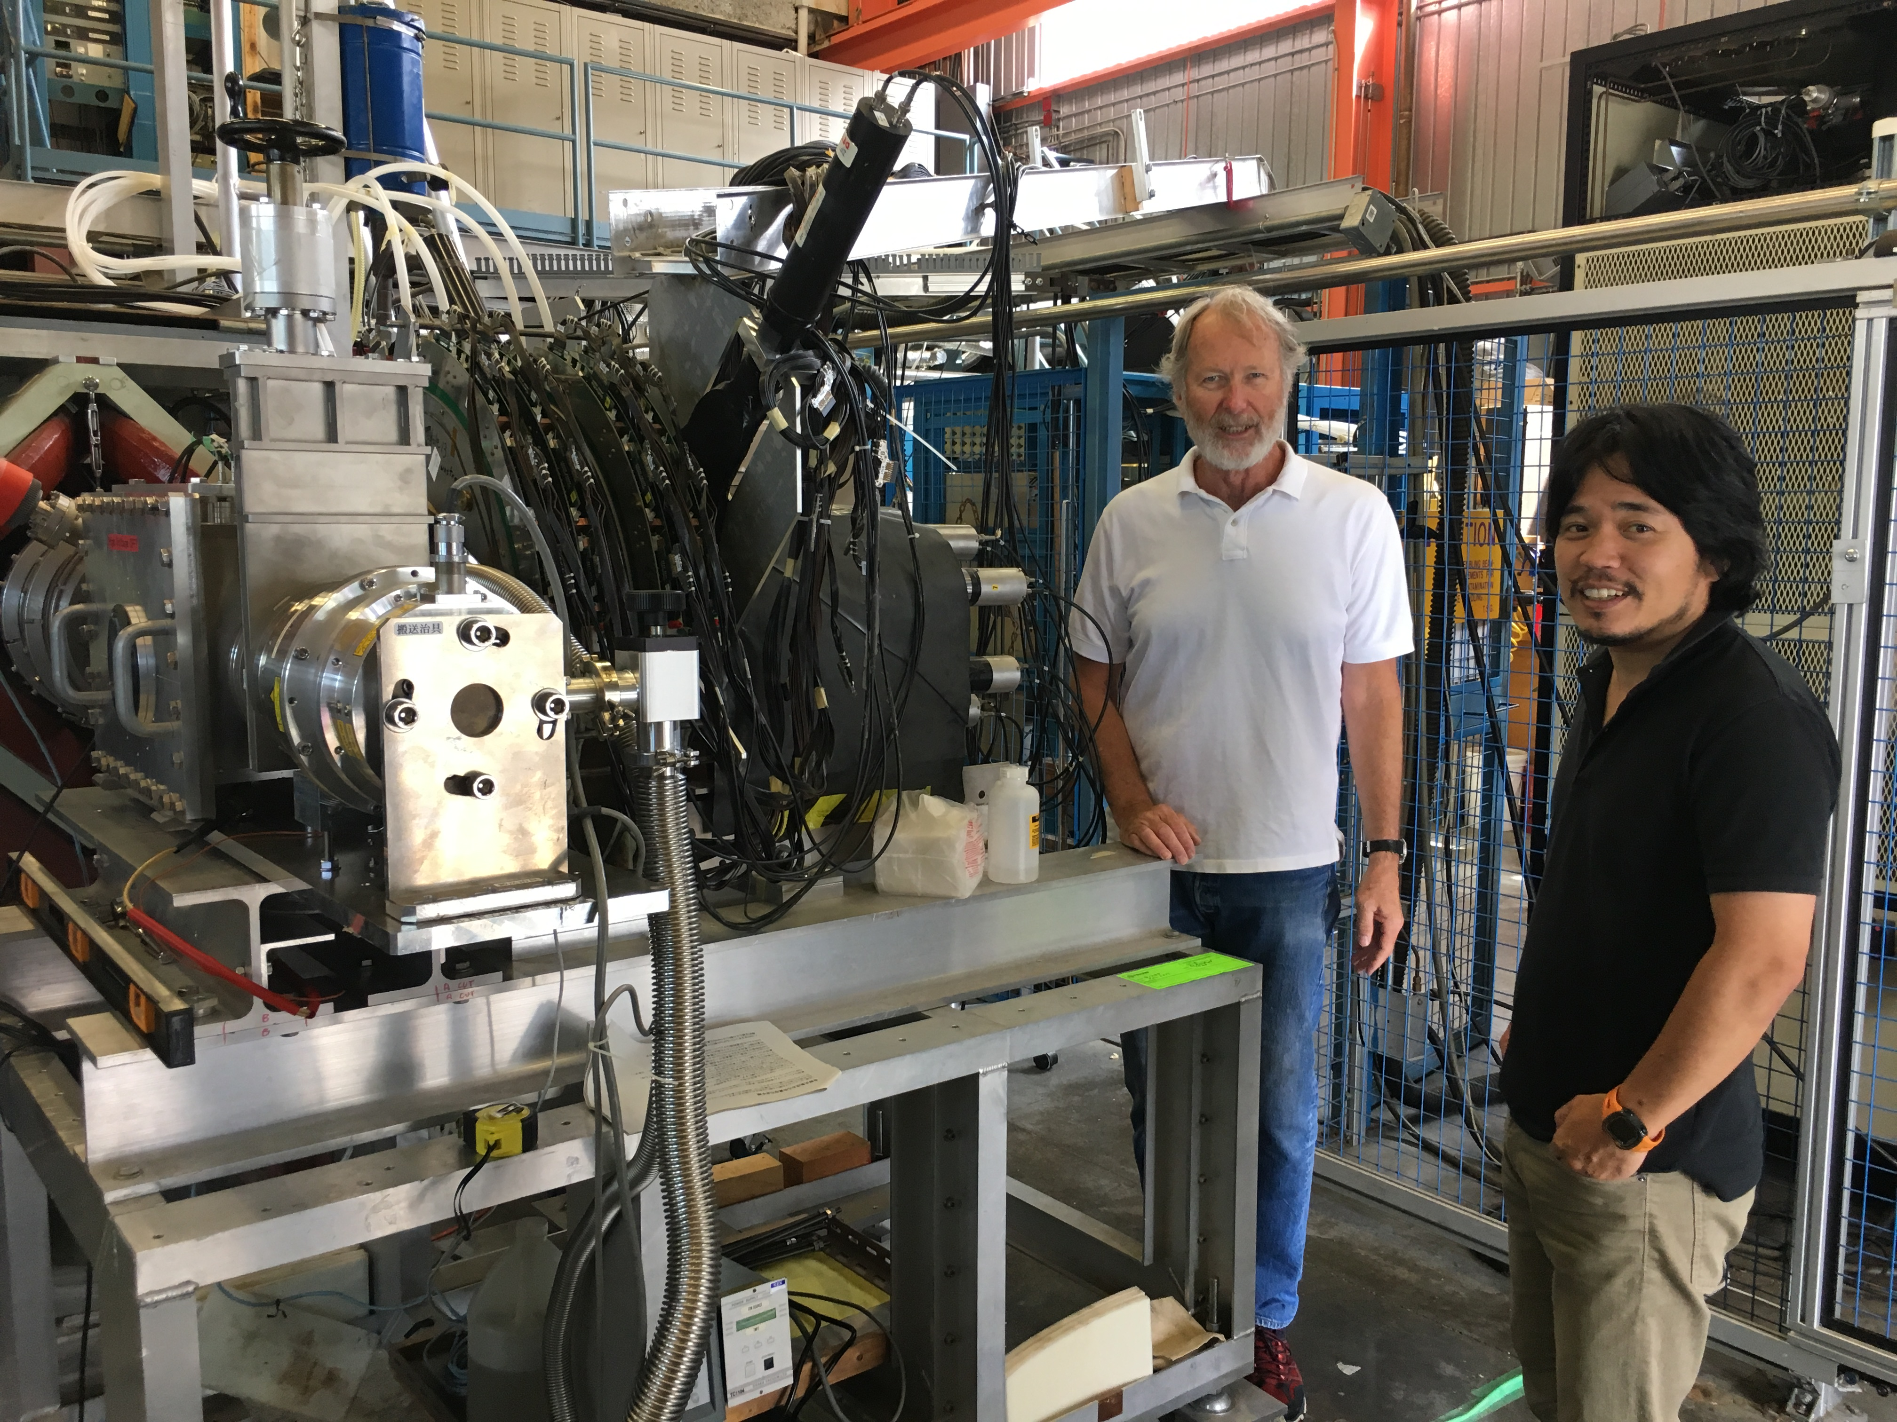
Mu production experiment at TRIUMF (June-July, 2017)
Tested 25 samples in 3 weeks.
2/3rd of them were produced during run on the fly

Slide 19
Long-term stability of Mu yield
TRIUMF-S1249
(Online data)
No hint of degradation observed for 2.5 days

Slide 20
Muonium spin precession in vacuum
TRIUMF-S1249
(Online data)
Reconfirmed polarization of Mu in vacuum.

Slide 21
Mu yields vs ablation parameters
Ablation area fraction
= [hole base area] / [emission face area] ∝ [aspect ratio]²
Continuous
ablation
Preliminary
Flat
2.5-3% Mu yield is necessary to achieve BNL precision.
This was confirmed by newly prepared samples.
Detailed analysis is on-going to understand the emission mechanism.

Slide 22
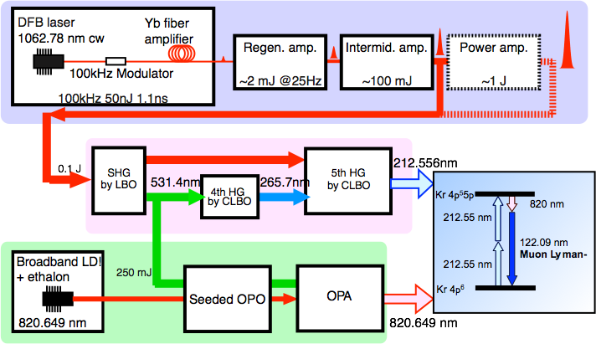
Schematic of laser system
Slide by Satoshi Wada (RIKEN)

Slide 23
Schematic of laser system
Slide by Satoshi Wada (RIKEN)
Generation of Lyman-α at J-PARC U-line
Lyman-α
guide laser
estimated energy = 8.4μJ (after LiF)
(design goal: 100μJ)

Slide 24
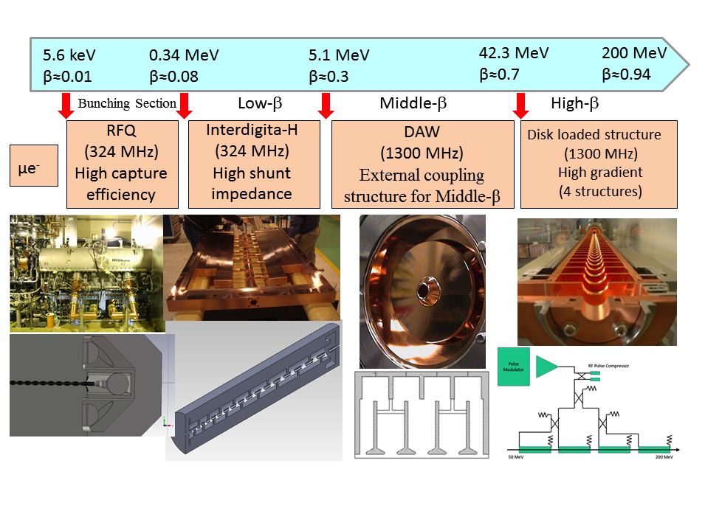
Adopted technology for muon acceleration
Bunching
Section
External coupling structure for low-β
Similar to electron accelerator to obtain high gradient.
High hunt impedance
M. Otani et al., Phys. Rev. Accel. Beams 19, 040101 (2016)

Slide 25
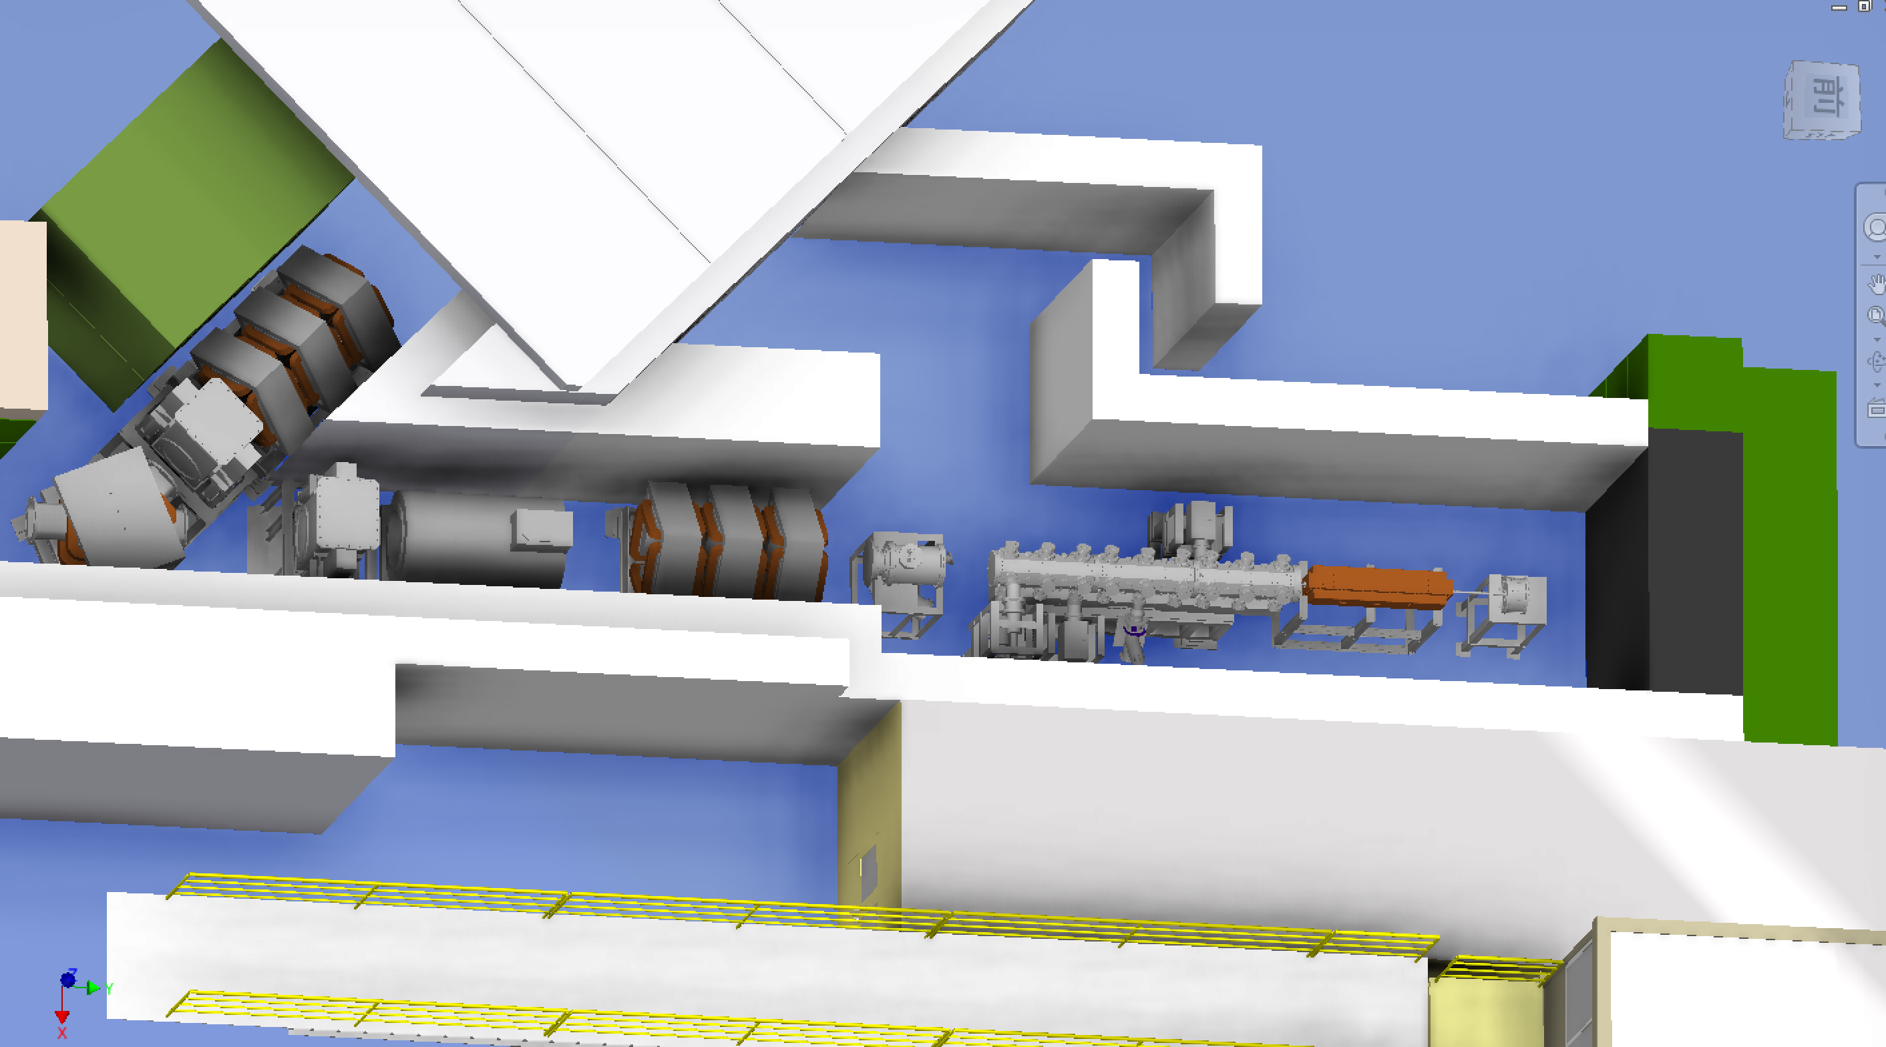
Beamline and muon accelerator at H-line
J-PARC MLF
Experimental Hall
H1 area
(MuSEUM/DeeMe)
Q-magnets
blocker
surface muon (4 MeV)
Mu
production
Initial
Accel.
RFQ
IH
Beam
diagnostics
detectors
Bend
magnet
Beam
Blocker
Solenoid
Q-magnets
accelerated muon (25meV→4.5 MeV)

Slide 26
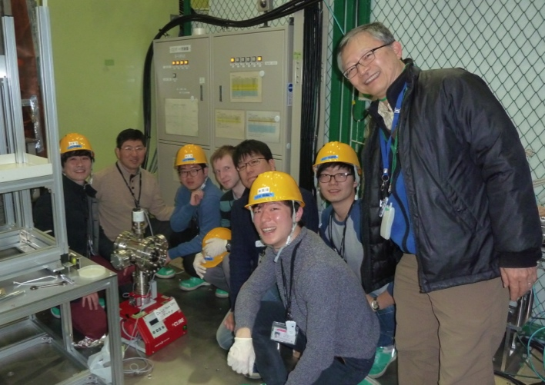
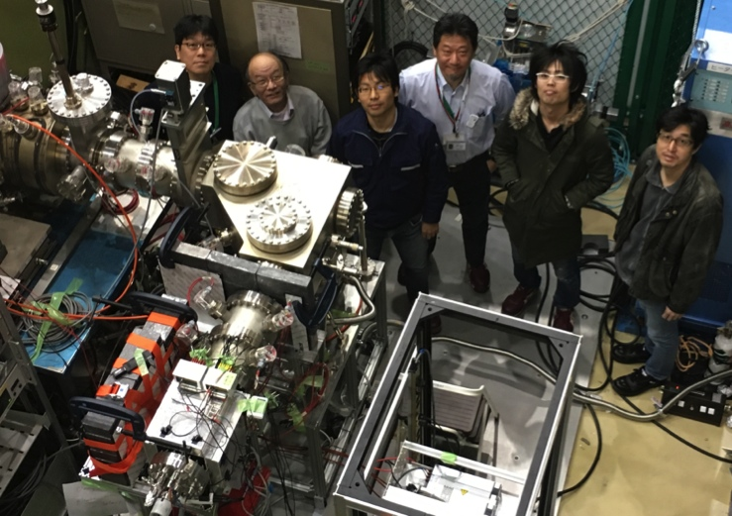
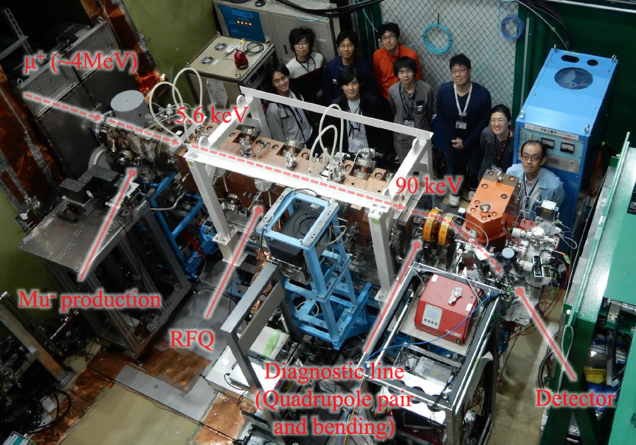
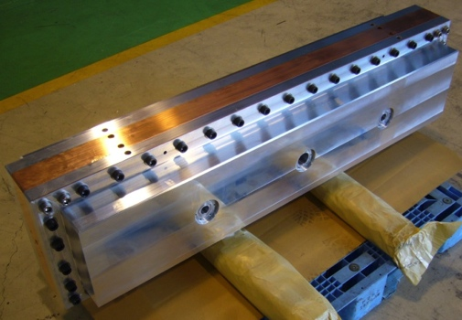
Beamline and muon accelerator at H-line
J-PARC MLF
Experimental Hall
H1 area
(MuSEUM/DeeMe)
Q-magnets
Tested in 2016
Tested in 2016
blocker
surface muon (4 MeV)
Mu
production
Initial
Accel.
RFQ
IH
Beam
diagnostics
detectors
Bend
magnet
Beam
Blocker
Solenoid
Q-magnets
accelerated muon (25meV→4.5 MeV)
Tested in 2016
Tested in 2017
Prototype

Slide 27
Muon RF acceleration for the first time!
J-PARC MLF D2 area, October 2017
Slide by M. Otani

Slide 28
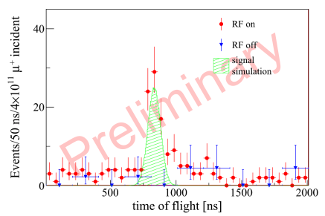
Muon RF acceleration for the first time!
J-PARC MLF D2 area, October 2017
Slide by M. Otani

Slide 29
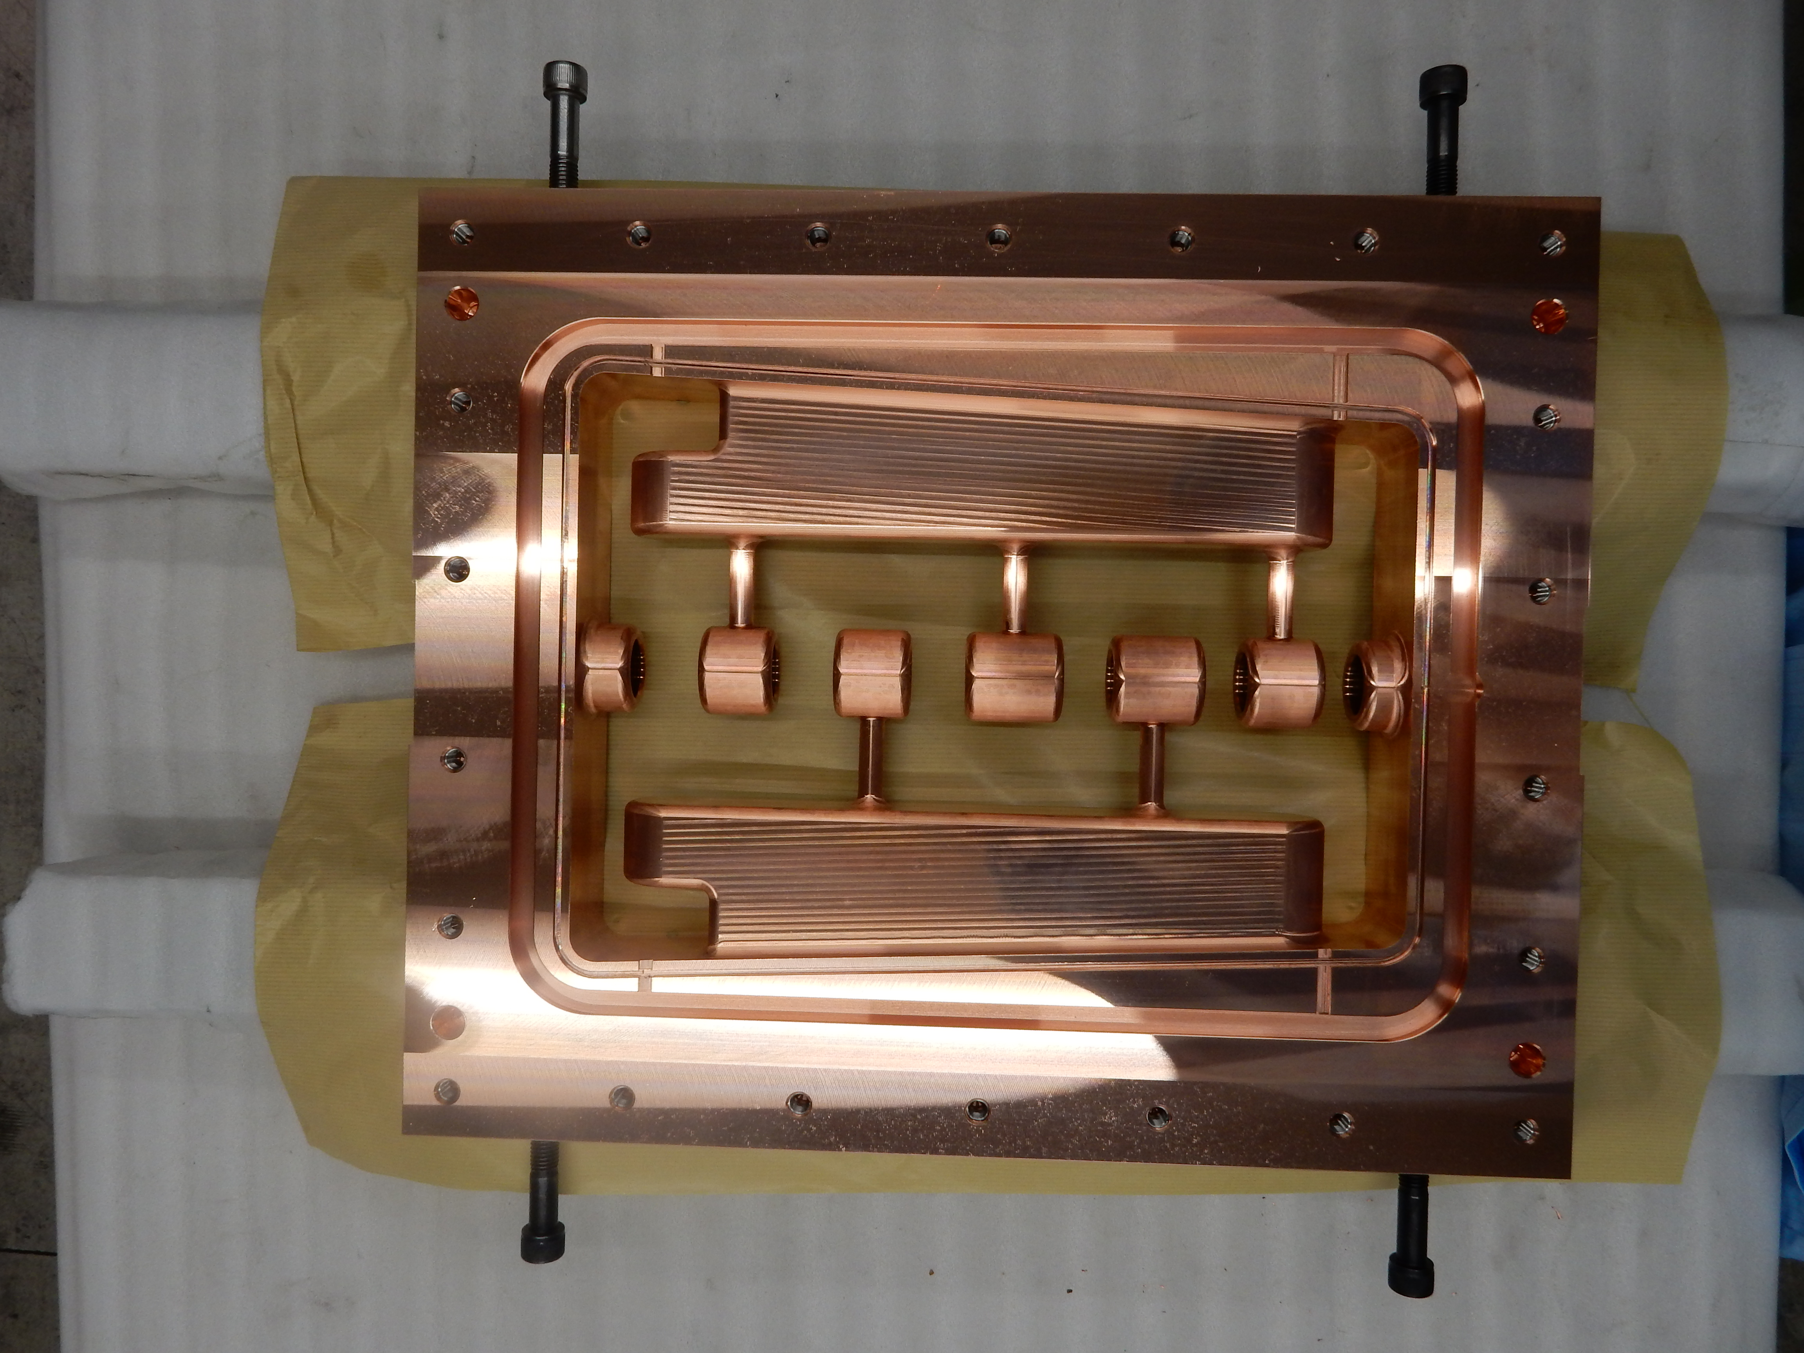
An accelerating structure (IH-DTL cavity) to 1.3 MeV
Mar 2017, Photo by M. Otani

Slide 30
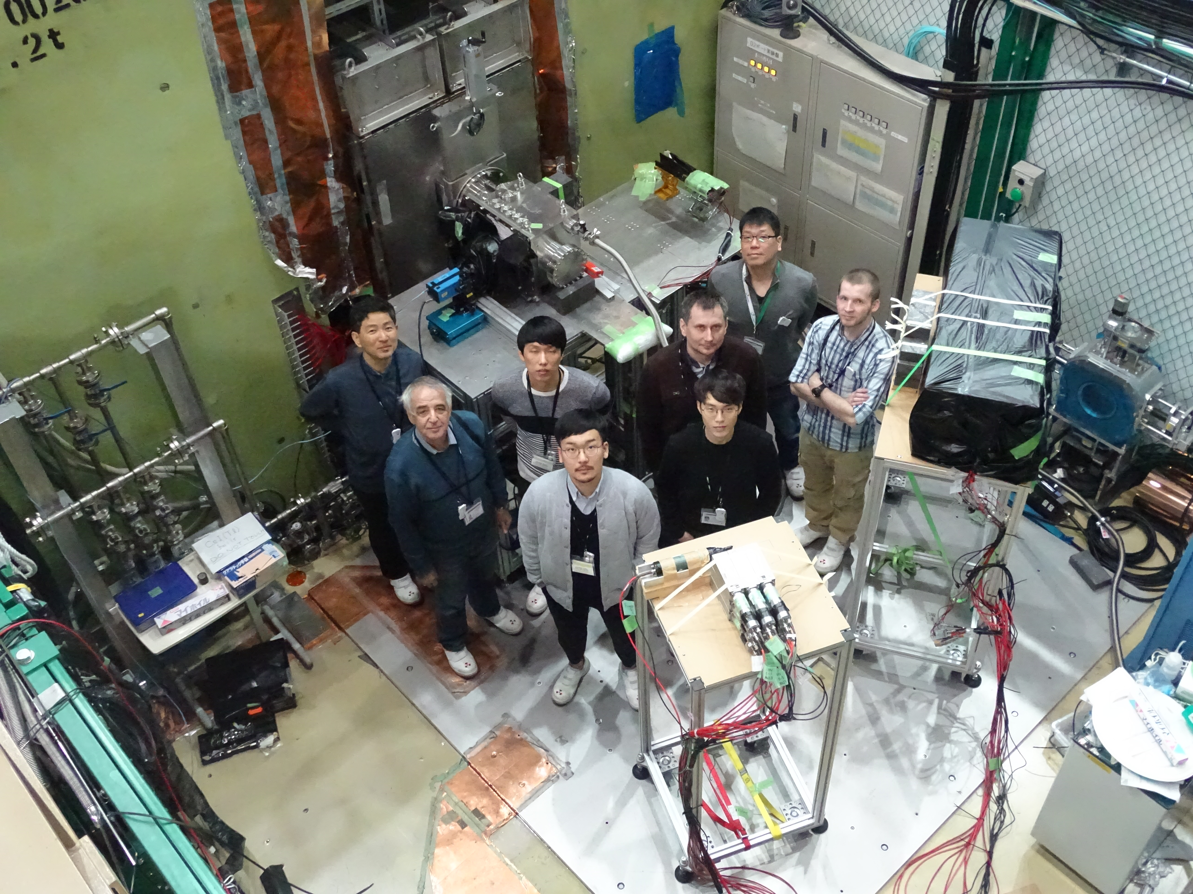
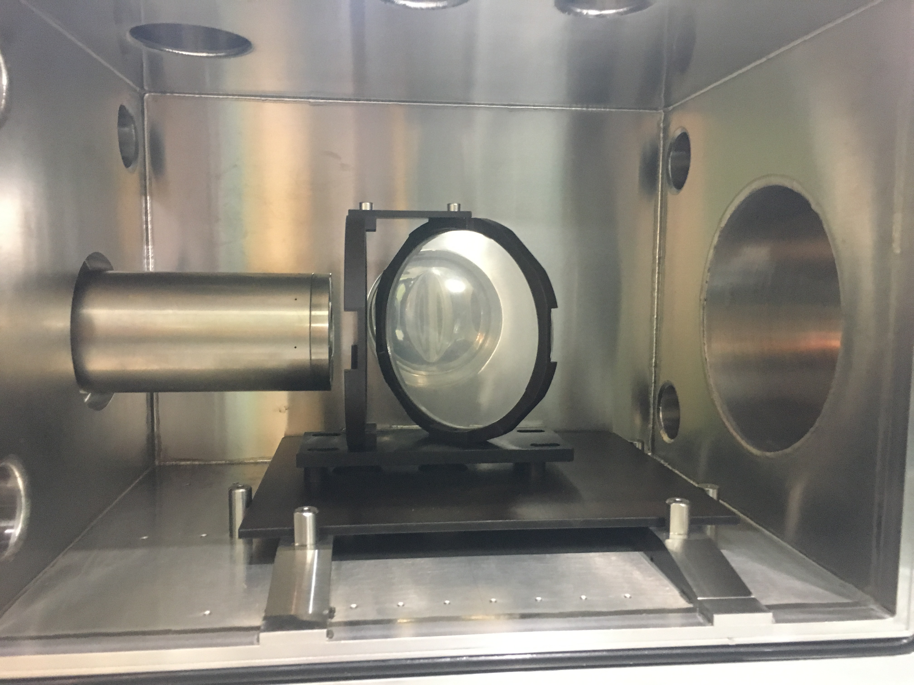
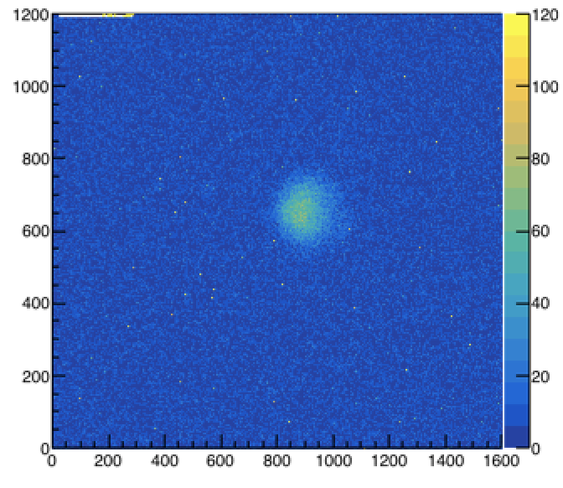
A test of thin beam profile monitor at J-PARC (Feb 2018)
BINP-SNU-KEK
CsI(Tl) film
(3μm)
Raw data
μ⁺

Slide 31
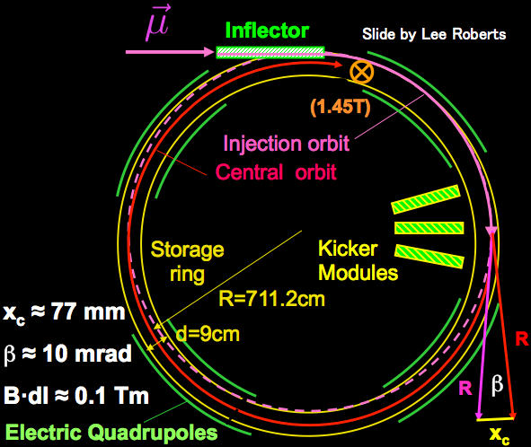
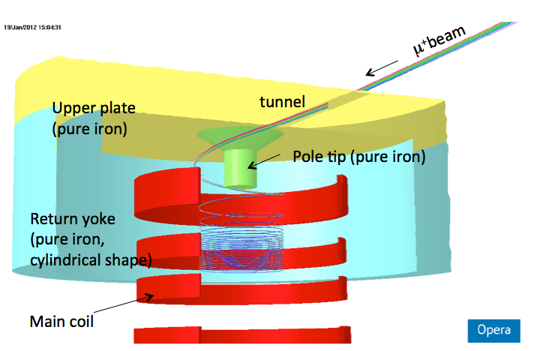
Muon beam injection and storage
Horizontal injection + kicker
(BNL E821, FNAL E989)
3D spiral injection + kicker
(J-PARC E34)
Injection efficiency : 3-5%(*)
(*) PRD73,072003 (2006)
Injection efficiency : ~85%
H. Iinuma et al., Nucl. Instr. And Methods. A 832, 51 (2016)

Slide 32
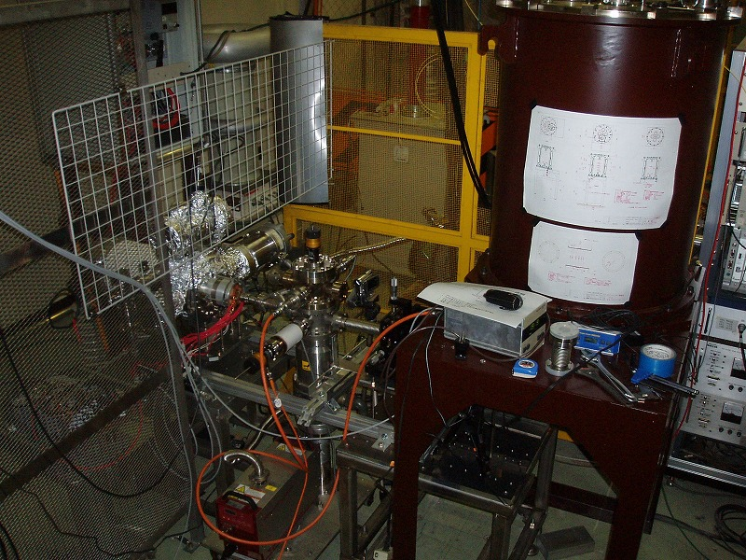
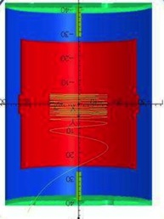
Demonstration of spiral injection with low-E electron beam in Tsukuba
Mini-solenoid
(102 G)
Electron gun
(112 keV/c)
Iinuma, Nakayama, Osawa, Rehman

Slide 33
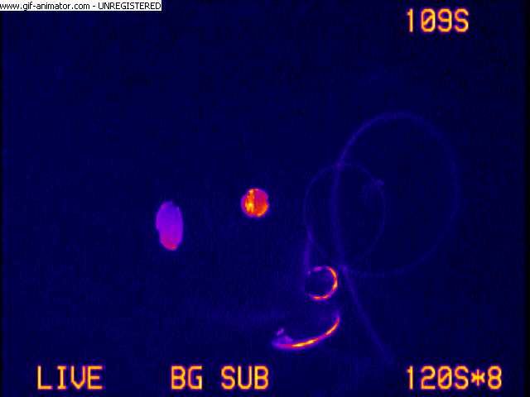
Spiral Injection Test Experiment with low-energy electron beam
Injection angle was changed from 47 to 44 deg.
Beam track
Mirror
Reflection from
chamber wall
Injection hole
Master thesis, M. A. Rehman (2017)

Slide 34
Muon storage magnet and detector
Drawn by Hitachi Co.
Iron yoke
Cryogenics
Muon storage orbit
2900 mm
e+ tracking
detector
Super conducting coils
666 mm
34
34
34
M. Abe et. al., Nuclear Inst. and Methods in Physics Research A 890, 51 (2018)

Slide 35
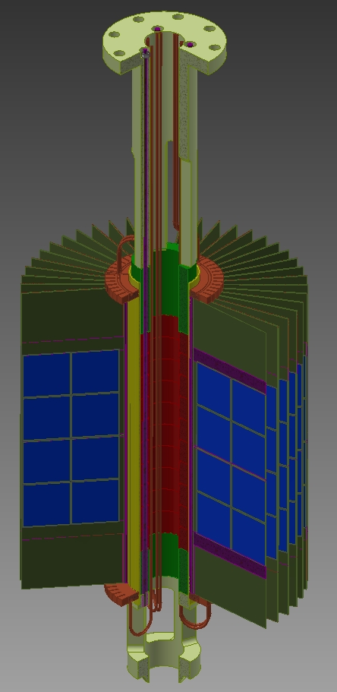
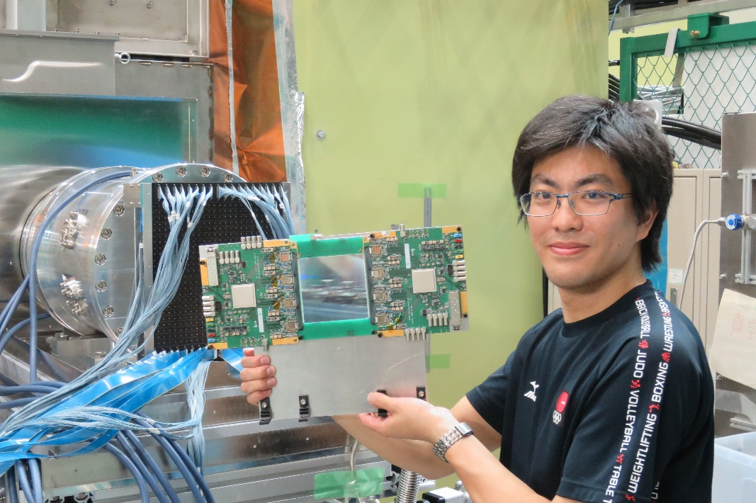
Positron tracking detector
A tracking detector ( vs. calorimeter)
Robust against pileups
Partial funding available to construct a part of detector system
First working test module
tested in Mu-HFS experiment (June 2017)
KEK
Mechanical
Engineering
Center

Slide 36
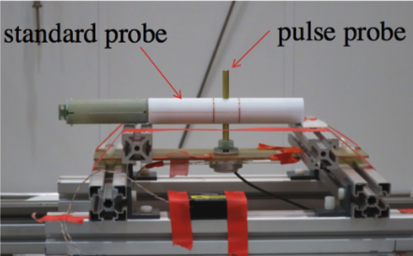
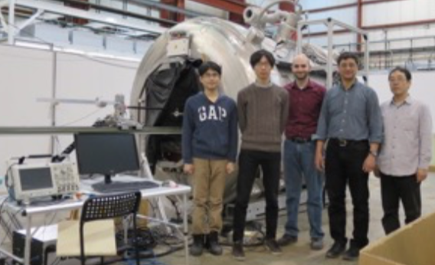
Cross calibration of NMR probes
MRI magnet for calibration
at ANL (1.45 T)
The NMR probes (J-PARC, FNAL E989)
J-PARC E34/MuSEUM
FNAL E989
Probe type | Frequency (Hz)
J-PARC | 617 176 44.5 ± 1.0 (15 ppb)
Fermilab | 617 176 44.9 ± 0.9 (14.7 ppb)
Difference | 0.4 ± 1.3 (21 ppb)
Preliminary
Agreement in 8 digits!

Slide 37
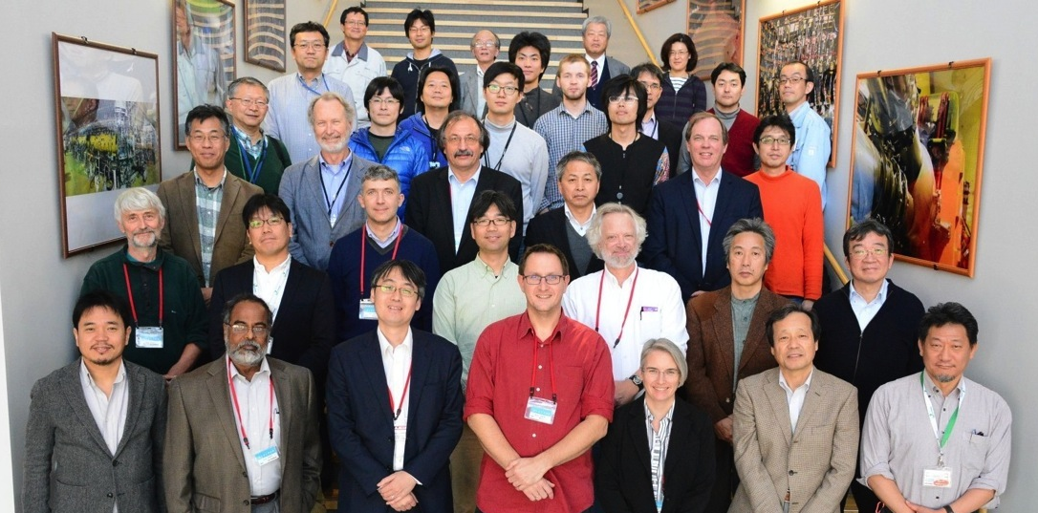
TDR focused review (Nov 15-16,2016)
The reviewers including leaders of the BNL and FNAL g-2 all agree that
E34 is an exciting and valuable independent approach which should be done ASAP.
a result with the BNL sensitivity (E34 phase-I) would be a huge contribution to the field.

Slide 38
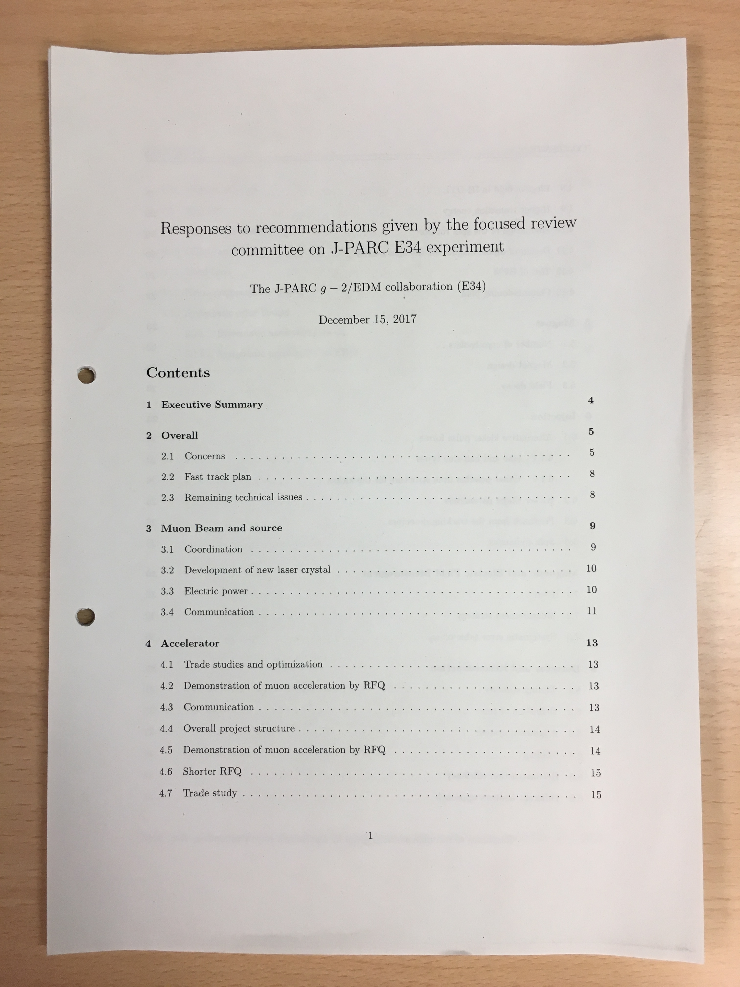
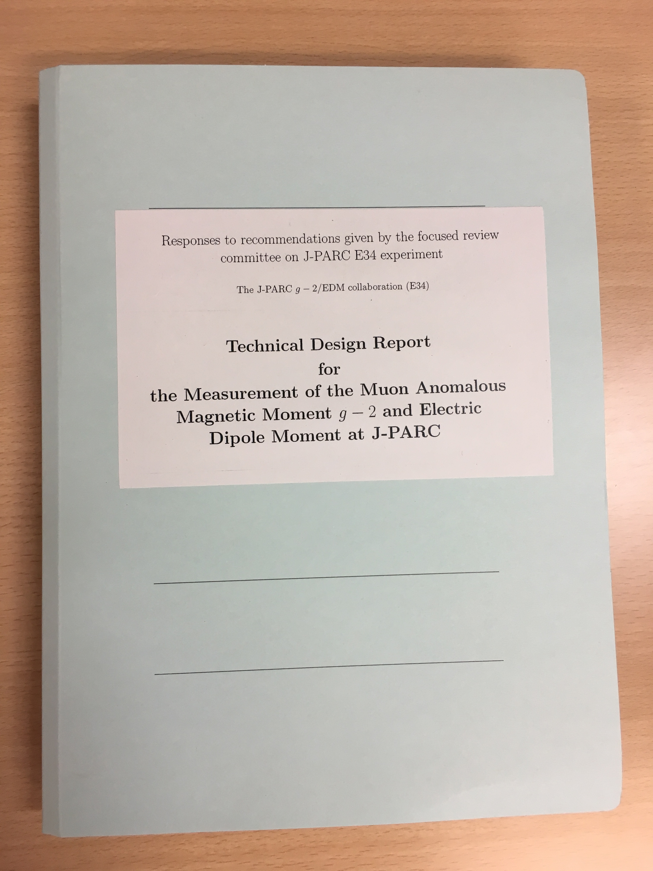
Responses and revised TDR
Submitted to PAC in Dec 15, 2017
One-by-one responses to
4 concerns
2 major recommendations
40 specific recommendations
with references to TDR
Revised incorporating
recommendations
Currently under review in the committees

Slide 39
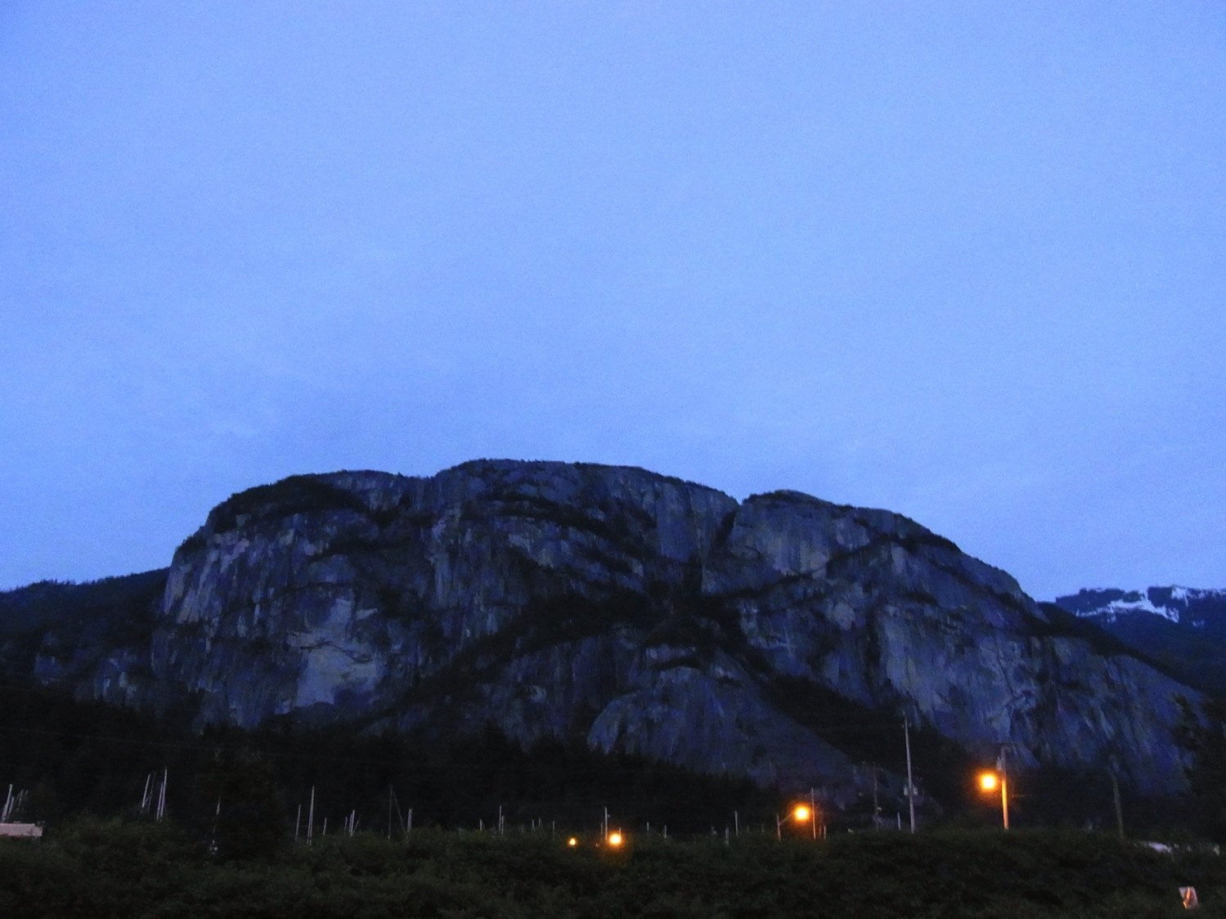
physics
data & results
construction
TDR
Squamish, BC (Canada)

Slide 40
Summary
The HVP workshop at KEK was a big success!
We have completed major part of homework assigned by PAC and the TDR review committee (FRC).
In addition, we have made major progress
First muon acceleration to 90 keV
Cross calibration of NMR probe in 20 ppb (8 digits)
Test of a thin beam monitor
Mu-HFS data taking with the “g-2 silicon detector” (MuSEUM)
In coming years,
Construction of muon beamline (H-line)
Demonstration of “muon cooling”
Re-acceleration to 1 MeV
Results from the MuSEUM experiment

